Slide 1
Redefining Race: The power of DNA in uniting societies
Ken Chahine, Ph.D., J.D. – AncestryDNA

Slide 2
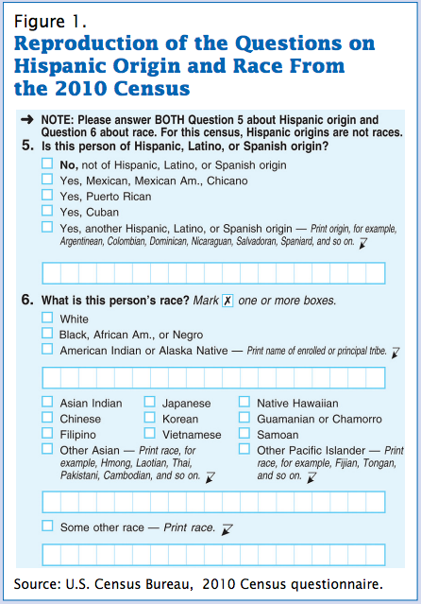

Slide 3
Fast-growing DNA database
Genotyped Customers
Projected to reach 1 million in 2015
2012
2013
2014

Slide 4
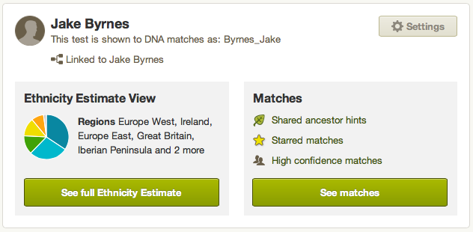
Test results: genetic ethnicity & matches
Notes:
Replace with my results

Slide 5
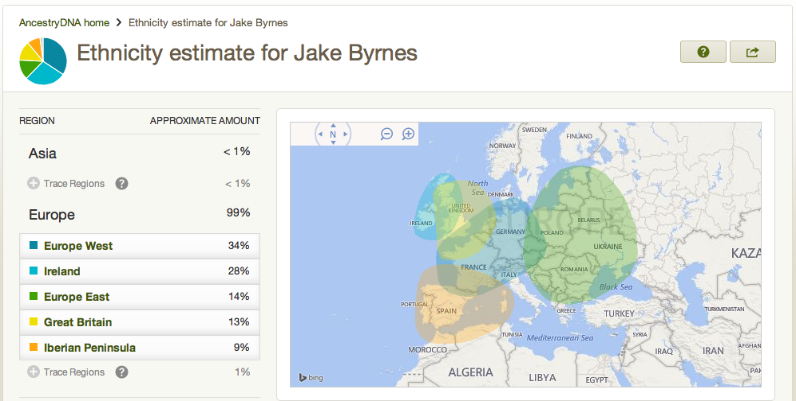
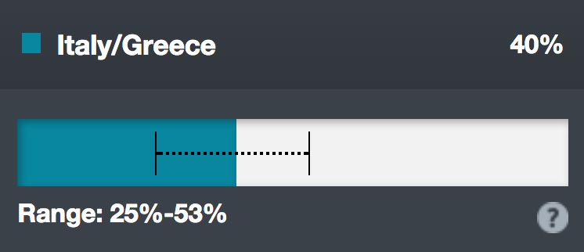
Genetic ethnicity
Notes:
Replace with my results & add call outs

Slide 6
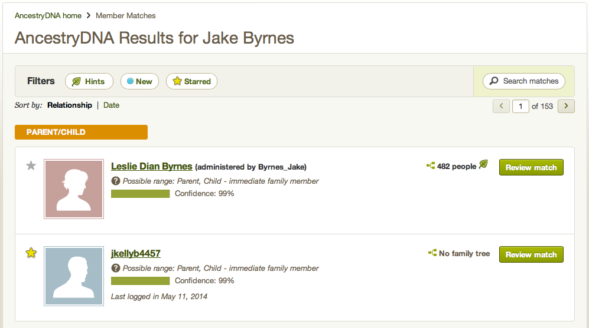
Genetic matches
Shaky Leaf
Notes:
Replace with my results & add call outs

Slide 7
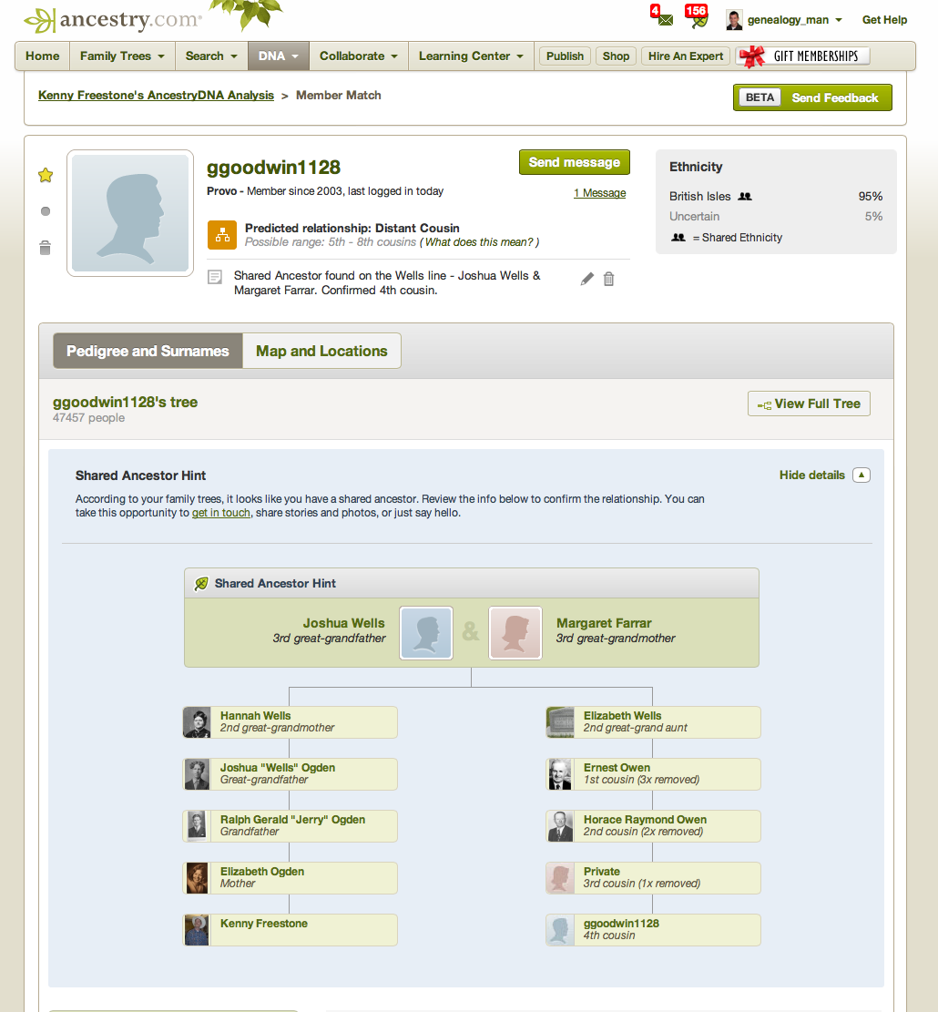
Shared ancestor hints
Common ancestor & path

Slide 8
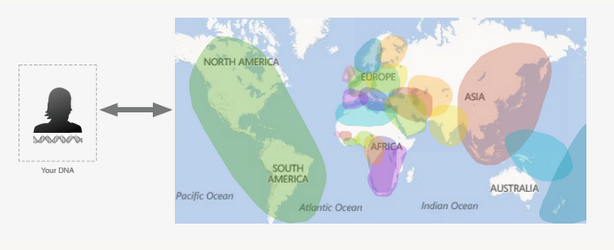

What is genetic ethnicity?
An estimate of the ancient historical origins of a customer’s DNA
Customer 700,000 SNP genotype
Reference panel of 3,000 DNA samples from 26 world populations

Slide 9
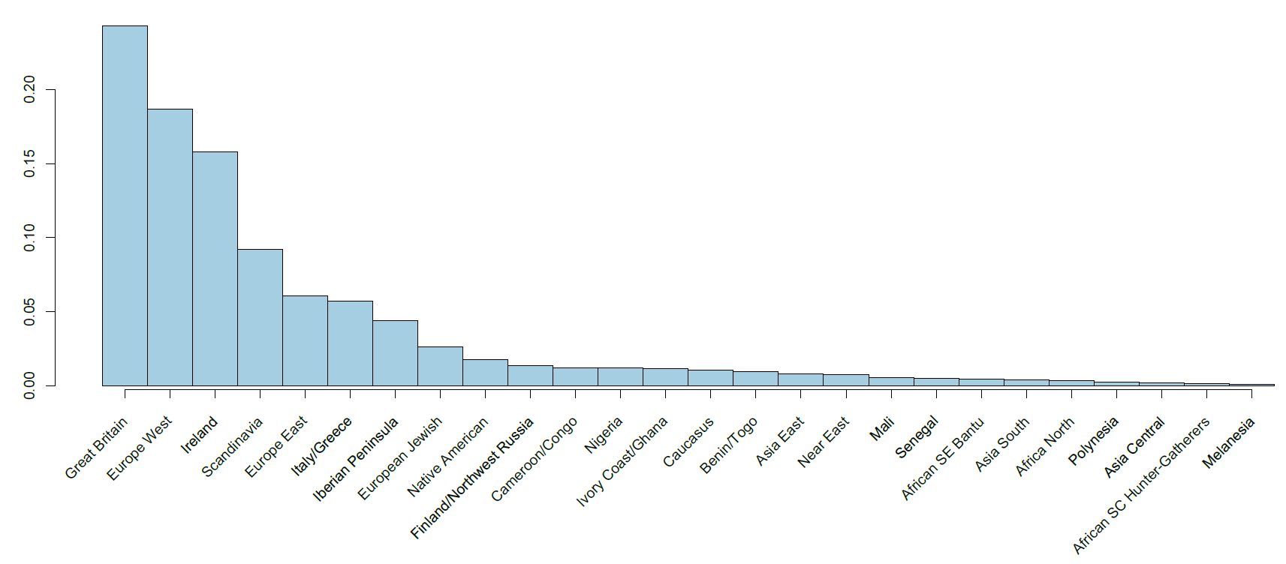
Database ethnicity distribution
Currently we market to US customers only

Slide 10
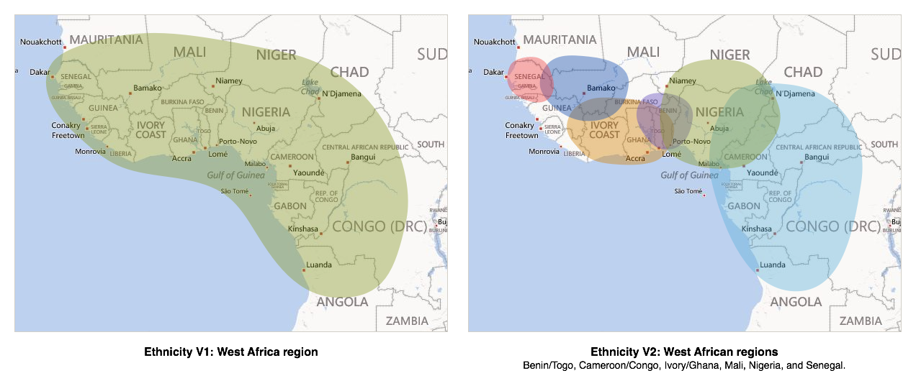
Ethnicity prediction: Western Africa

Slide 11
Genetics mimic geography
Nigeria
Senegal
Mali
Ivory Coast
Ghana
Benin
Togo
Congo
Cameroon

Slide 12
Genetics mimic geography
Nigeria
Senegal
Mali
Ivory Coast
Ghana
Benin
Togo
Congo
Cameroon

Slide 13
Genetics mimic geography
Nigeria
Senegal
Mali
Ivory Coast
Ghana
Benin
Togo
Congo
Cameroon

Slide 14
Genetics mimic geography
Nigeria
Senegal
Mali
Ivory Coast
Ghana
Benin
Togo
Congo
Cameroon

Slide 15
Genetics mimic geography
Nigeria
Senegal
Mali
Ivory Coast
Ghana
Benin
Togo
Congo
Cameroon

Slide 16
Genetics mimic geography
Nigeria
Senegal
Mali
Ivory Coast
Ghana
Benin
Togo
Congo
Cameroon

Slide 17
Genetics mimic geography
Nigeria
Senegal
Mali
Ivory Coast
Ghana
Benin
Togo
Congo
Cameroon

Slide 18

Genetics mimic geography
Nigeria
Senegal
Mali
?
Ivory Coast
Ghana
Benin
Togo
Congo
Cameroon

Slide 19
Database distribution
Network Effect of IBD Matching
2
average number of 3rd cousin matches per customer
50
average number of 4th cousin matches per customer
2012
2013
2014
Confidential
Notes:
Matching 1.0

Slide 20
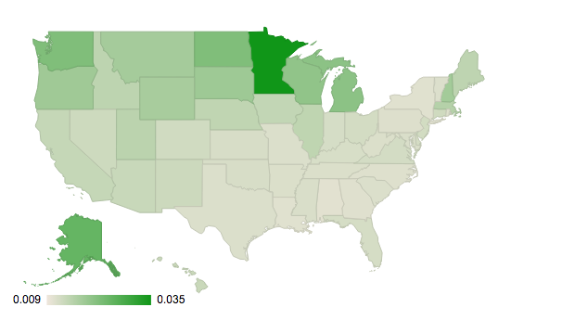
Finland/Northwest Russia

Slide 21
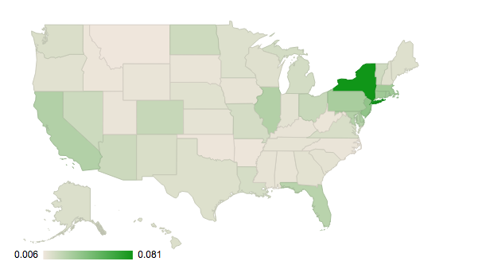
European Jewish

Slide 22
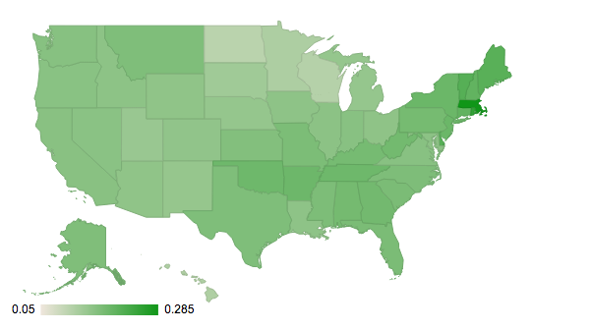
Irish

Slide 23
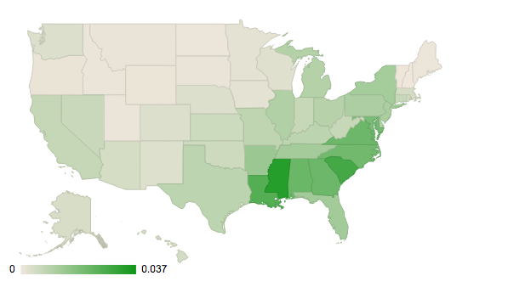
African American

Slide 24
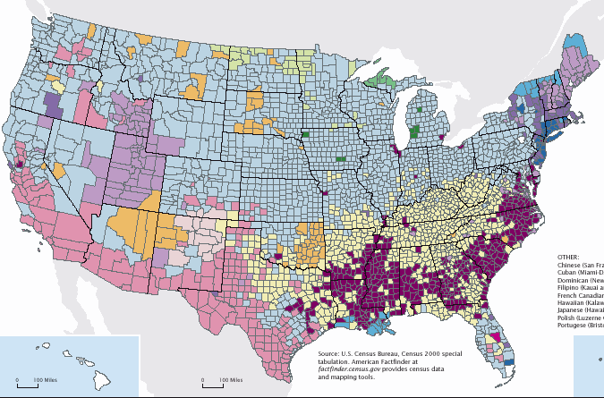
US Census
Scandinavian
Irish
American?
African American
Hispanics

Slide 25
A pedigree view of ethnicity

Slide 26
A pedigree view of ethnicity

Slide 27
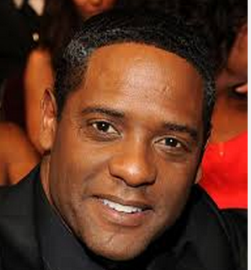


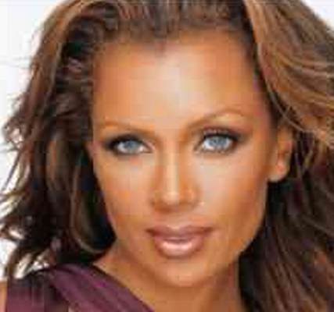
Hidden African and European ethnicity
Number of customers
Proportion of W. African Ethnicity

Slide 28
Who is African American or Hispanic?
“Do we have an estimate of the percentage of Hispanics and African Americans in our database?”
“If we define African American as >66% African, we have 30,388 African Americans in our database.
“If we define Hispanic as American + Europe_Iberian >0.5, where neither Native American nor Europe_Iberian > 0.8, we have 14,752 Hispanics in our database. Of course, this is a little less clear because lots of Hispanics have a significant amount of EuropeS.”

Slide 29
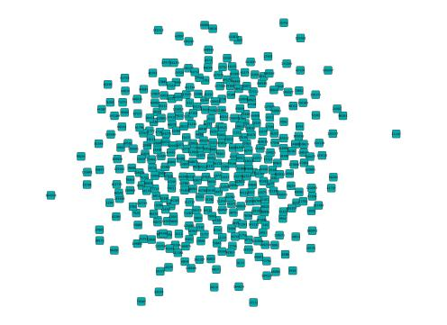
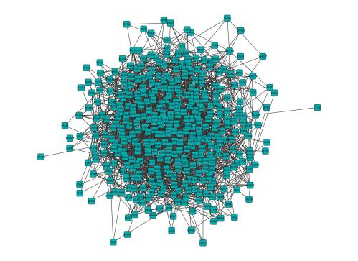

Common ancestor networks
?
?

Slide 30


Six Two genetic degrees of separation
Cousins matches
(0.46% of the database)
Cousins matches’ matches
(>90% of the database)
Customer with US Roots

Slide 31
Why DNA matching is so powerful
0.0001875
Chance that a random pair of individuals share
enough DNA to be considered 4th cousins:
200
Number of people in the room:
19,900
The number of ways I could pick two different people in this room:
97.6%
Chance that there is at least one pair of genetic 4th
cousin pairs in the room:
Notes:
Math is wrong

Slide 32
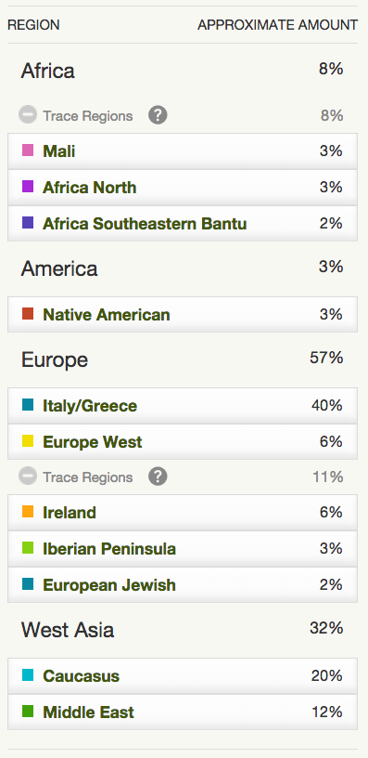
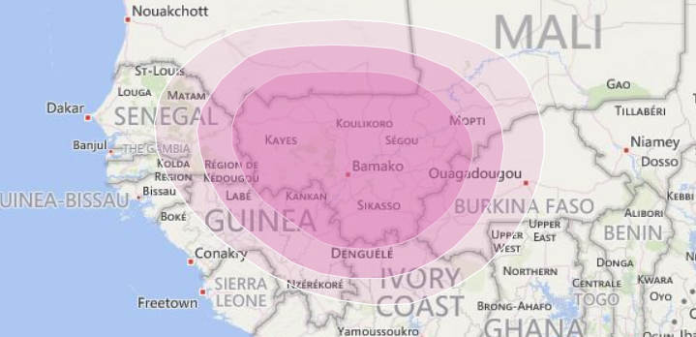
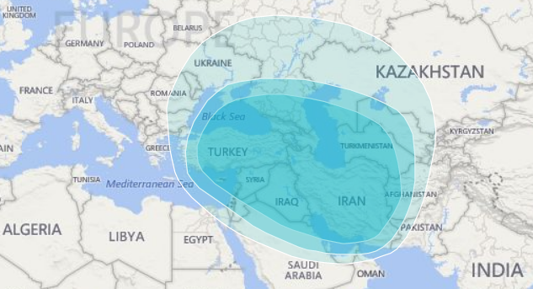
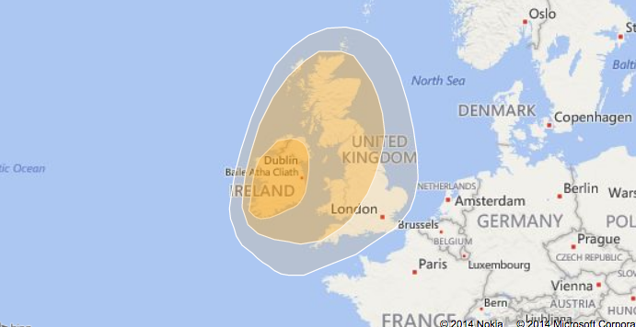

Slide 33
For the first time in the Census 2000, people could self-identify with more than one race
Black of African American – a person having origin in any of the Black racial groups of Africa.
Under my team’s definition, I am not “Hispanic.”
Under my team’s definition, Vanessa Williams is not “African American.”

Slide 34
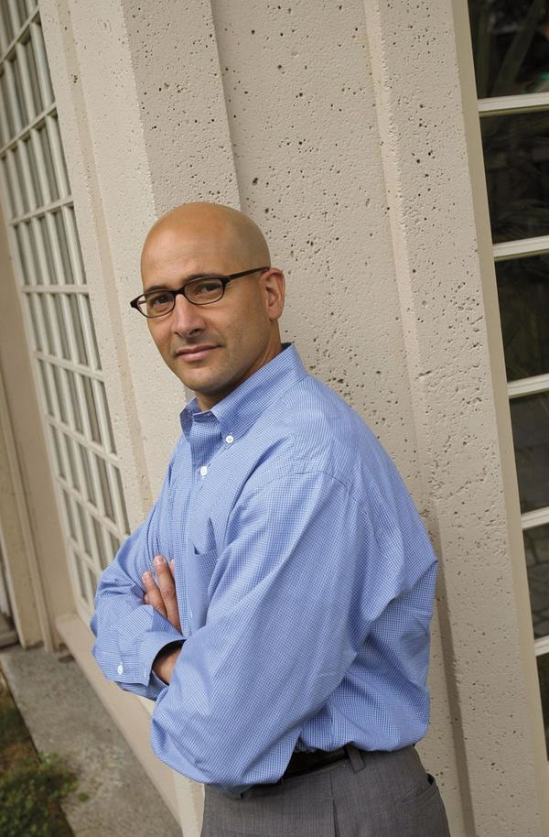







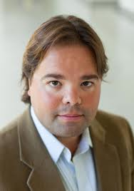







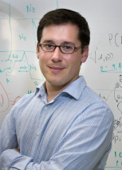
Who we are
AncestryDNA Science Team
Scientific
Advisory Board
Ken
Chahine
Catherine Ball
Natalie Myres
Jake
Byrnes
Keith Noto
Mathew Barber
Philip
Awadalla
Jeffrey
Botkin
Carlos
Bustamante
Yong Wang
Ross Curtis
Julie Granka
Peter
Carbonetto
Eunjung
Han
Amir
Kermany
Mark
Daly
John
Novembre

