Slide 1
Global Burden of Disease
Analyzing and visualizing big data in Global Health
Washington, DC, September 6, 2013
Peter Speyer
Director of Data Development
speyer@uw.edu / @peterspeyer

Slide 2
IHME
Institute for Health Metrics and Evaluation, University of Washington
Providing independent, rigorous, and scientific measurement and evaluations
“Our goal is to improve the health of the world’s populations by providing the best information on population health”
Core funding by the Bill & Melinda Gates Foundation and the State of Washington
Created in 2007
80 researchers, 60 staff

Slide 3
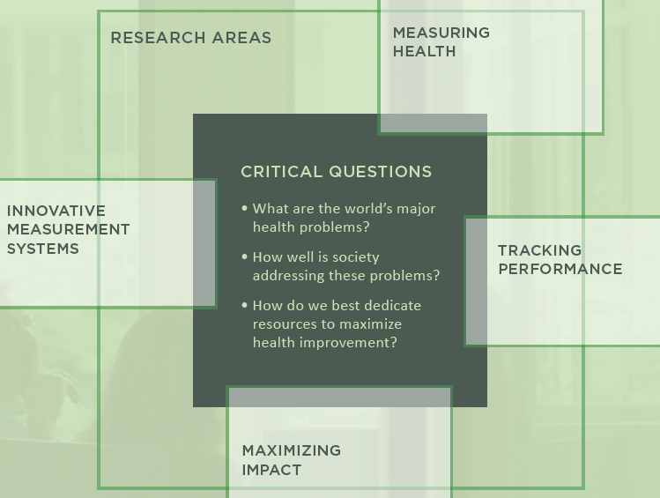

Slide 4
The Global Burden of Disease Study
A systematic scientific effort
to quantify the comparative magnitude of
health loss due to diseases, injuries and risk factors
by age, sex, geographies for specific points in time.
Collaboration with 488 individuals from 300 organizations in 50 countries
Published in 2012 in the Lancet

Slide 5
Understanding burden
Disability Weight
YLDs
YLDs
YLLs
Deaths
YLLs (Years of Life Lost)
YLDs (Years Lived with Disability)
DALYs (Disability-Adjusted Life Years)
Death
Maximum
life
expectancy

Slide 6
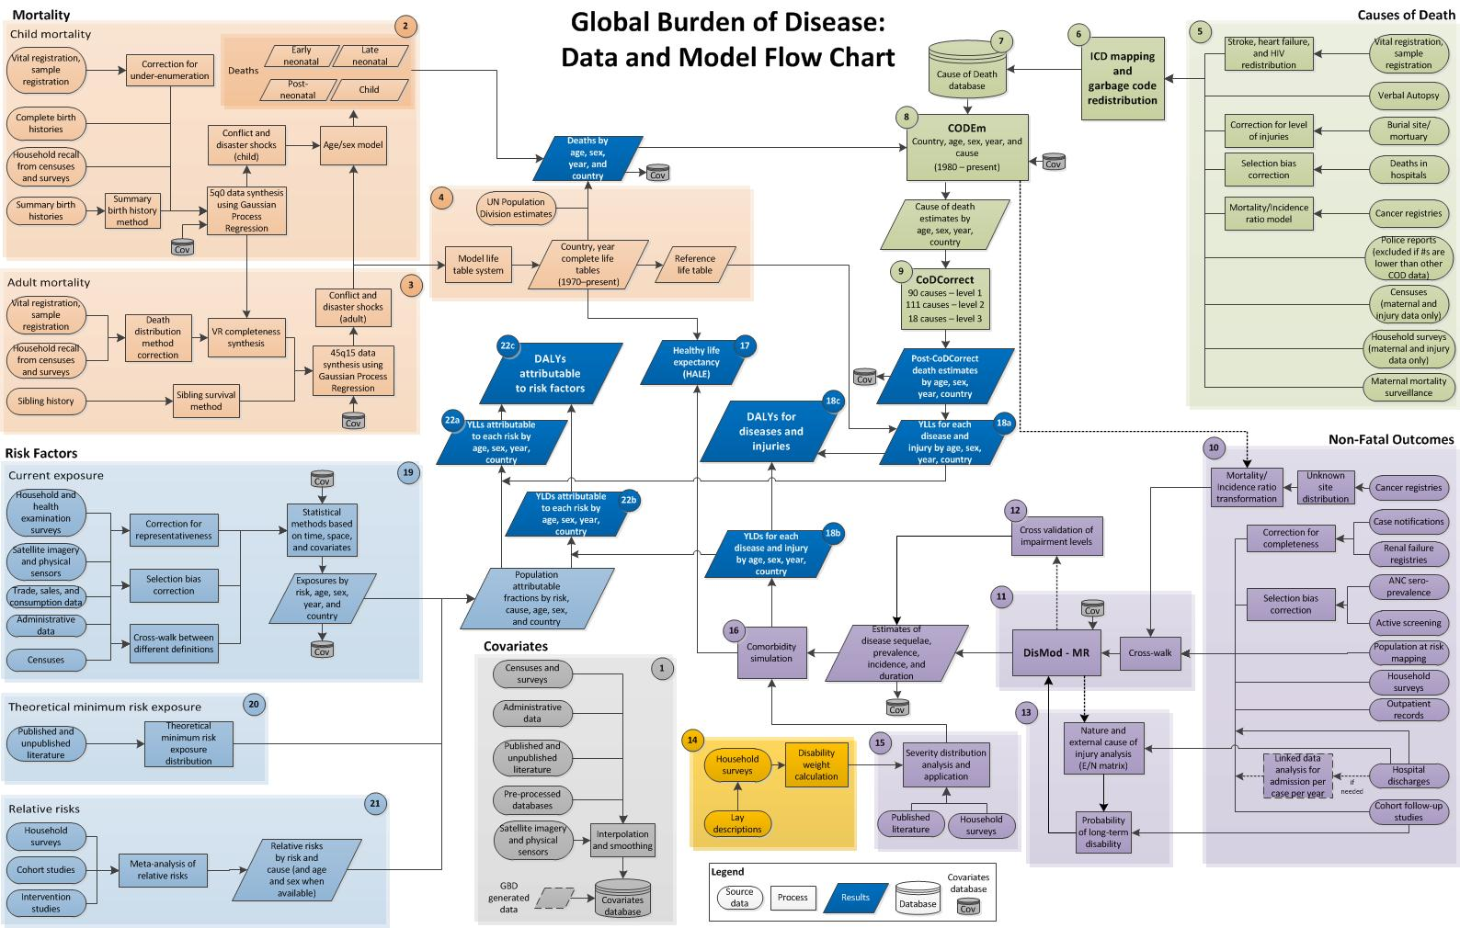
GBD Data and Model Flow Chart

Slide 7
GBD – it’s big data
Surveys
Censuses
Vital registration
Disease registries
Hospital records
Surveillance systems
Mortuaries / burial sites
Police records
Literature reviews
187 countries
1990, 2005 and 2010
291 causes / 1160 specific outcomes
66 risk factors
20 age groups
Male/female/total
5 key metrics: deaths, YLLs, prevalence, YLDs, DALYs

Slide 8
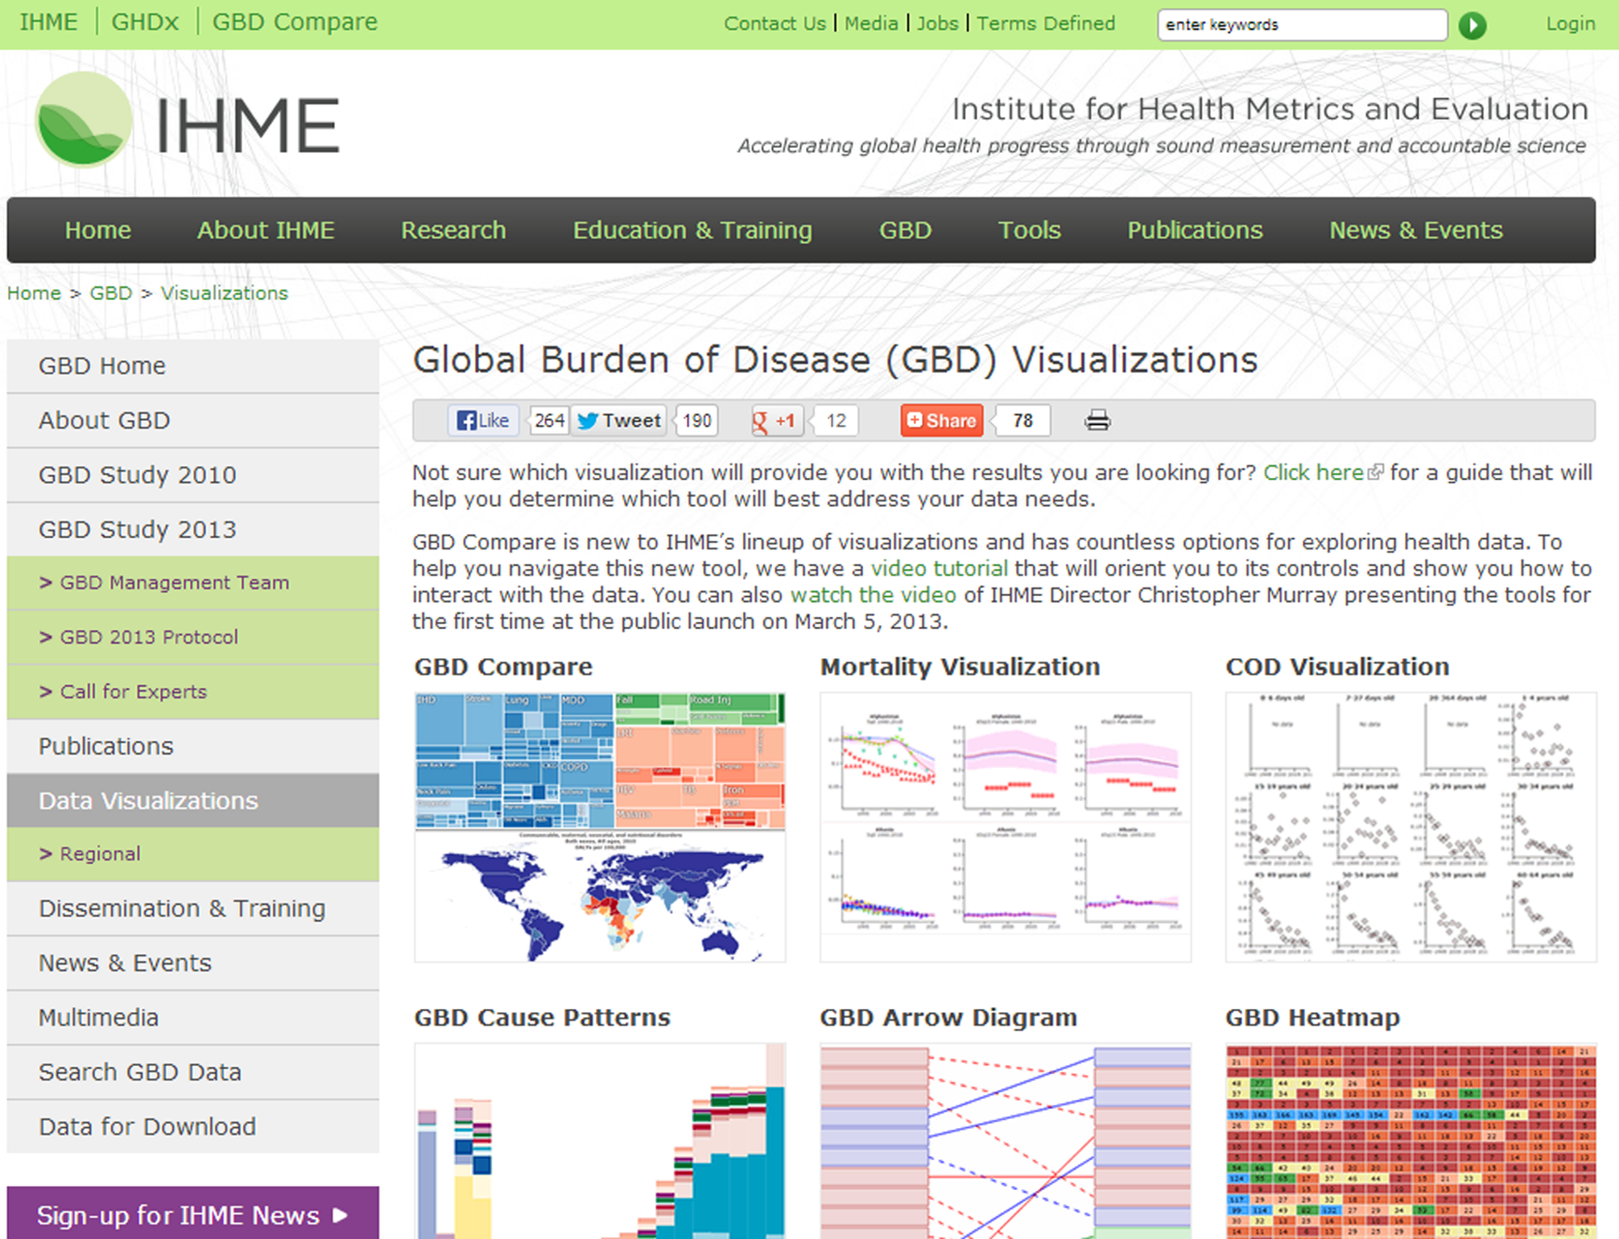

Slide 9
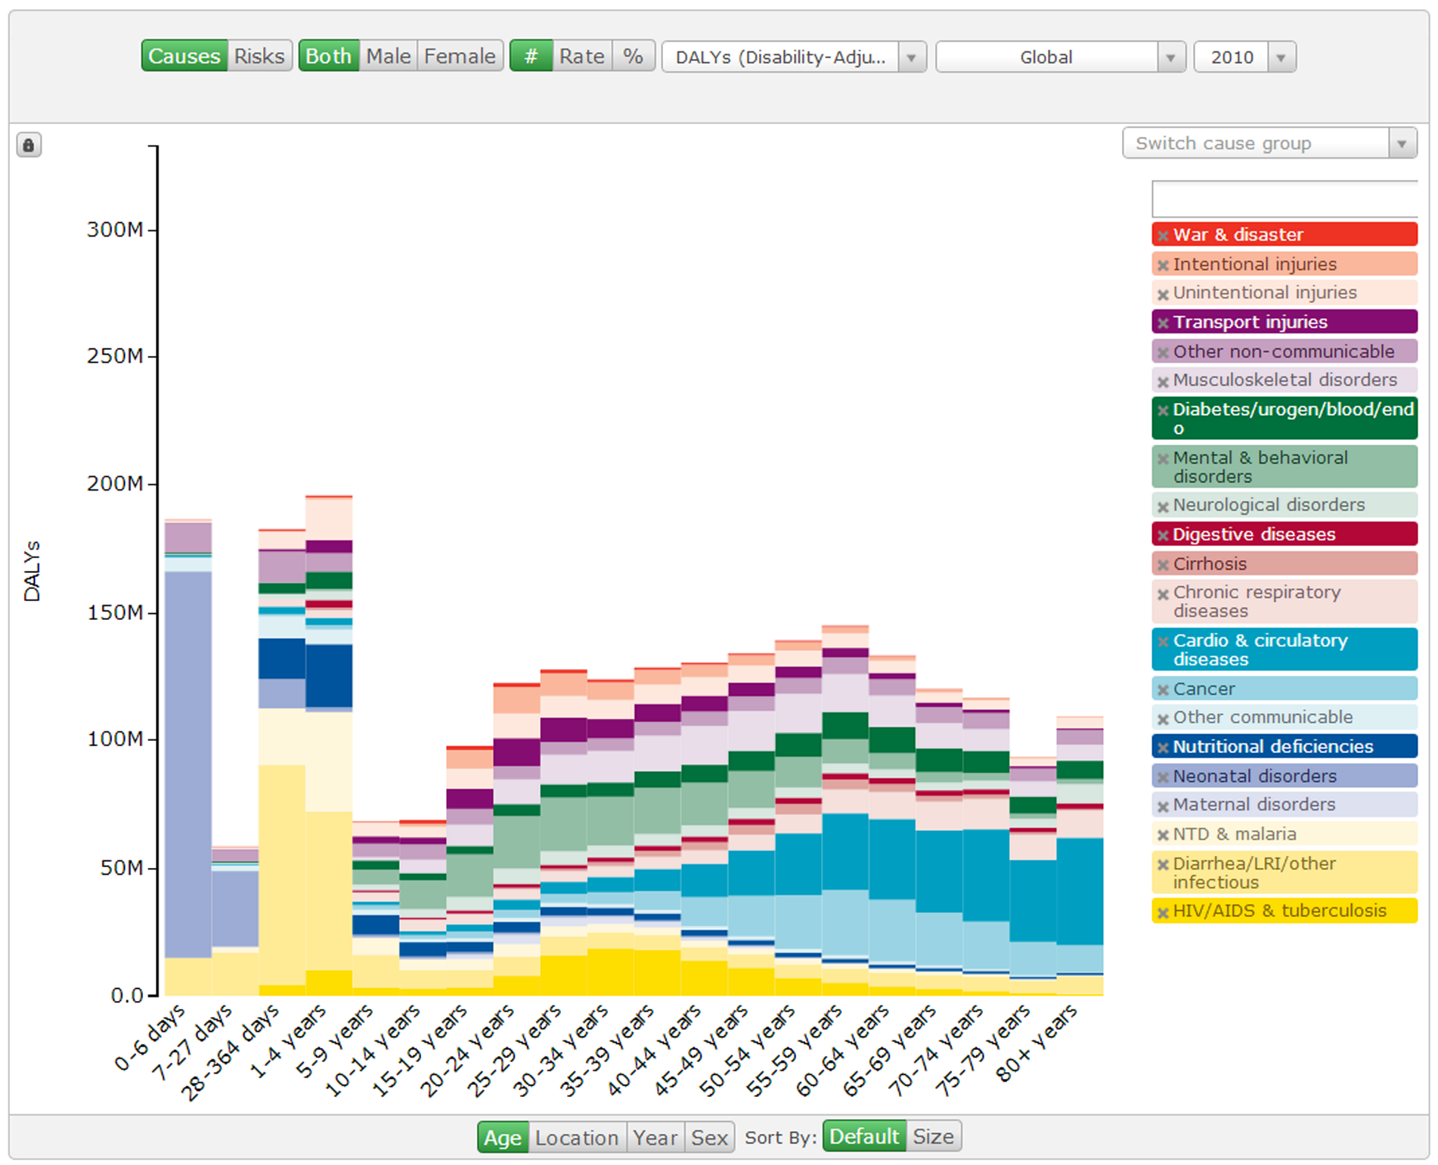

Slide 10
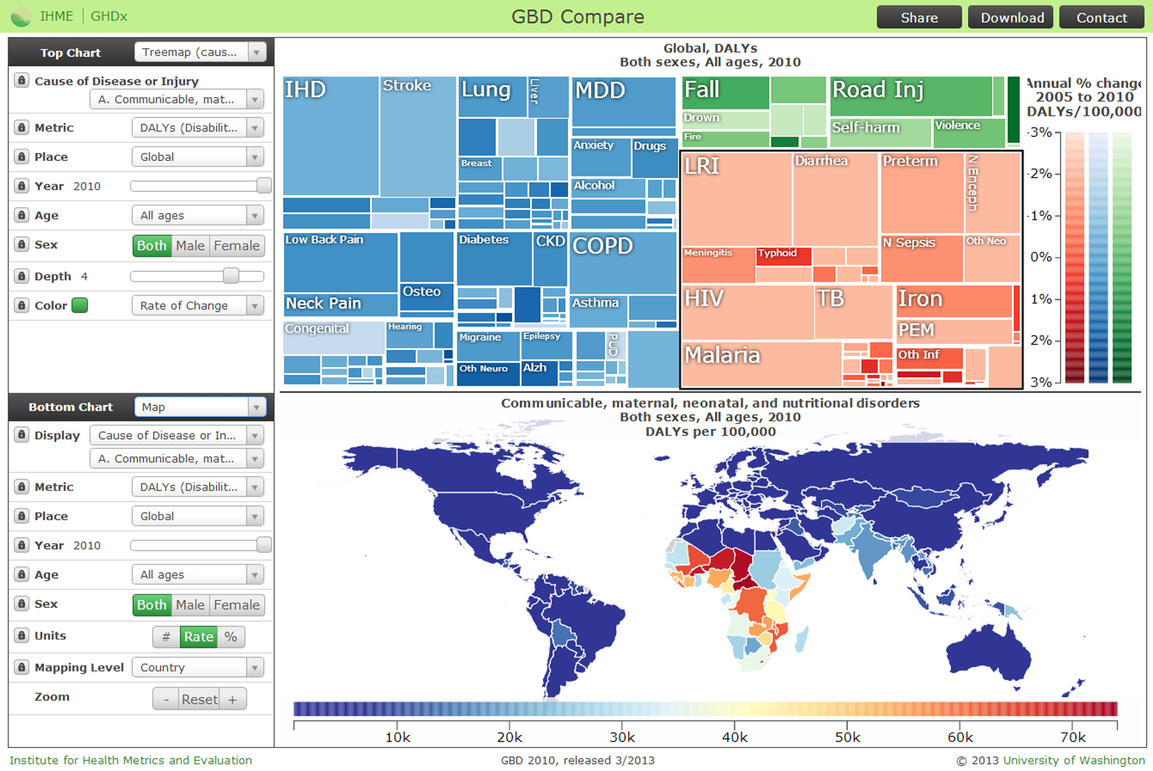

Slide 11
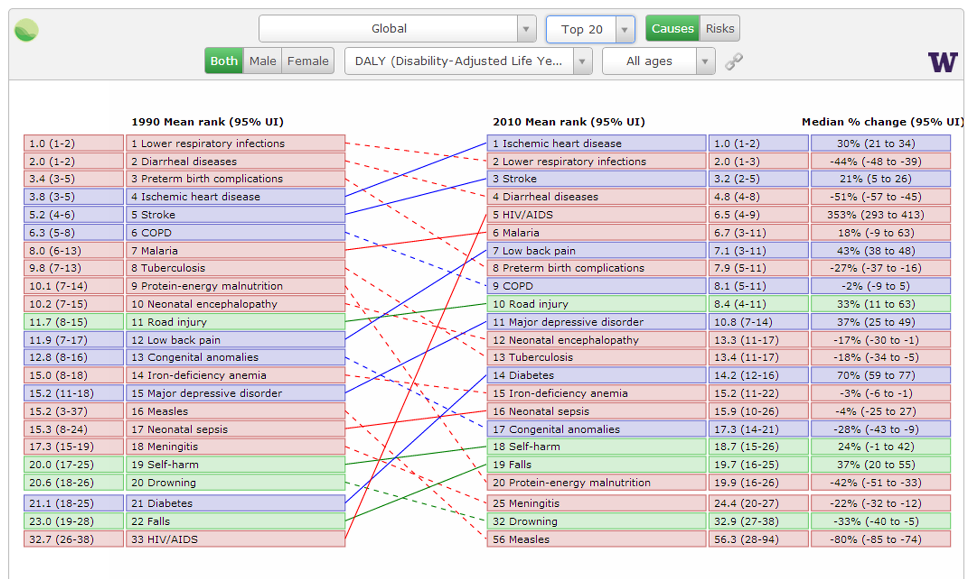

Slide 12
Global Burden of Disease
Analyzing and visualizing big data in Global Health
Peter Speyer
Director of Data Development
speyer@uw.edu / @peterspeyer
http://ihmeuw.org

