Slide 1
Transforming legacy data into state-of-the-art interactive visualizations
September 6, 2013 | Washington , D.C.
Mark Elbert
Director, Office of Web Management

Slide 2
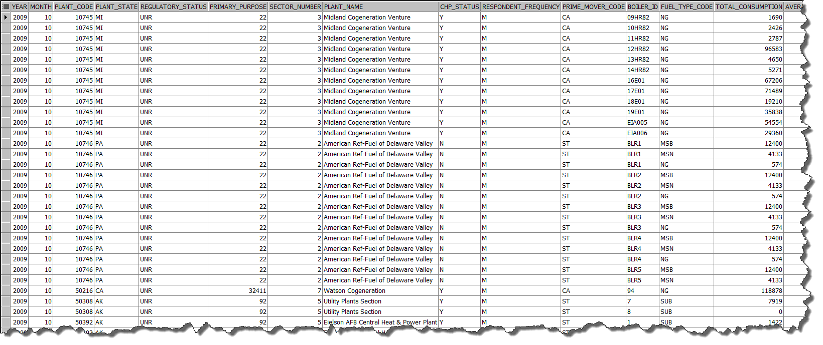
What to do when your data is in legacy table structures?
Notes:
Main frame process to drive a paper publications system. Paper system became PDF system. Electricity data = 20 million points organized into 400,000 time series. PDF system constrained to a handful of slice of the data that can fit onto 8.5 x 11 page. Which meant researchers and users to create time series by hand. Interviewed CRS.
Non-relational, but good enough. SHOW!

Slide 3
Challenge: transform EIA’s data publishing
chose electricity data, with over 400,000 time series, to break the paper-centric publishing model
different customers consume data in different ways:
researchers and energy analysts
classroom of students
Hill staffers
application developers
push the boundaries of interactive charting and mapping on the web
Notes:
Conducted user research to interview 12 users.
My development team and I had become very impressed with the capabilities of the free open-source javascript libraries. In fact, I was surprised at what we were able to do

Slide 4
The Internet’s fallow period: ’03 - ’10
The internet turned into a powerful computing platform despite Microsoft
Telcos gave us multi megabit bandwidth
Google’s Chrome started the new browser war for speed
processors continued to improve
open-source JavaScript libraries matured
jQuery / jQueryUI
jVectorMaps
Highcharts
Notes:
The new normal (Amazon.com) is for a web page to download > 1MB of code. Chrome v1.0 released in late ’08; it’s only been 5 years. In fact,

Slide 5
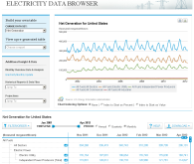
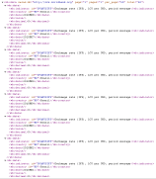
Web Data Ingestion and Application Architecture
legacy tables
Data
mapper
Filtering & collating
Indexing engine
Data writer
Web DB
(JSON)
Notes:
Time series stored in web DB in CLOB field as JSON strings:
Much faster to access a single text field than to assemble 2,000 individual points
Always transmit entire string
Can always lop off unneeded points on the server
Don’t try this with XML!

Slide 6
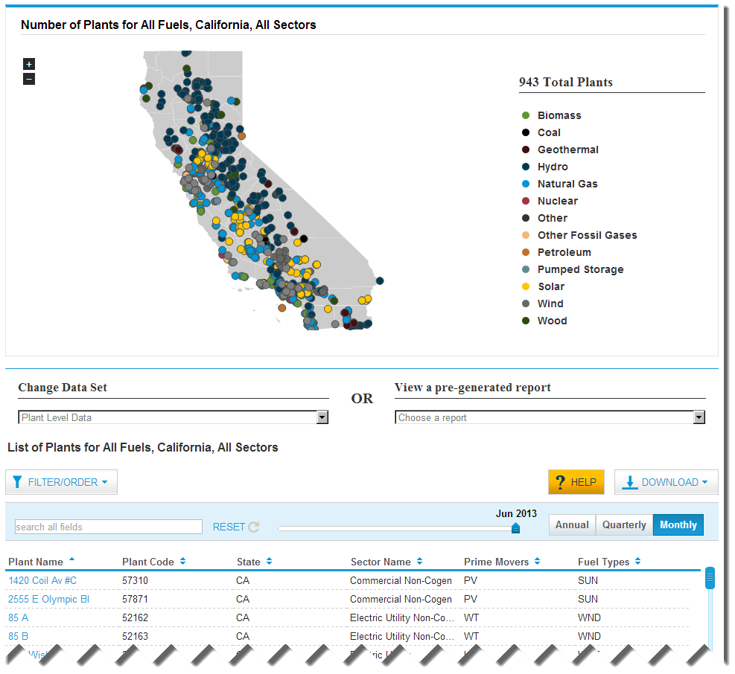
The Electricity Data Browser
aggregate data
drill-downs to individual plant data
user generated visualizations:
Line charts
Column charts
Animated maps
links to analysis, data API
Cross links to U.S. Energy Mapping System

Slide 7
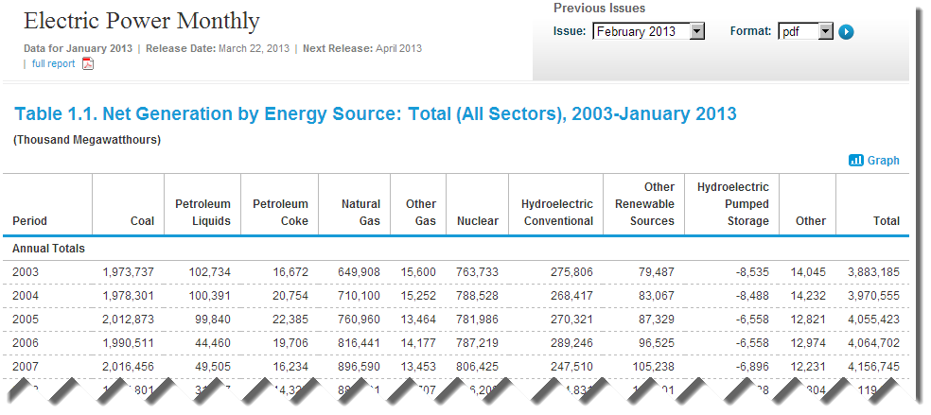
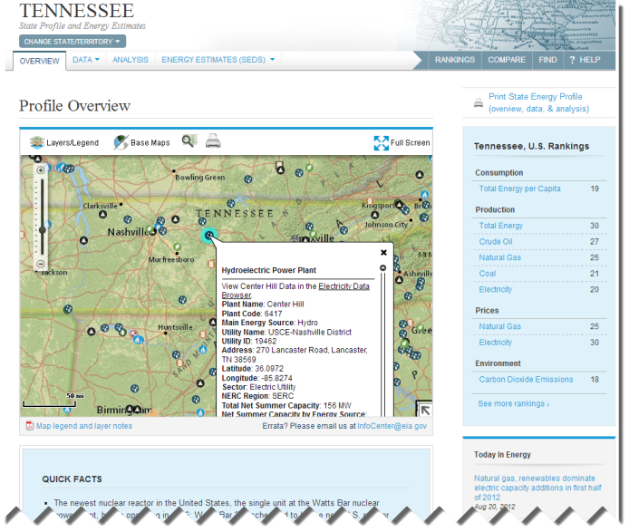
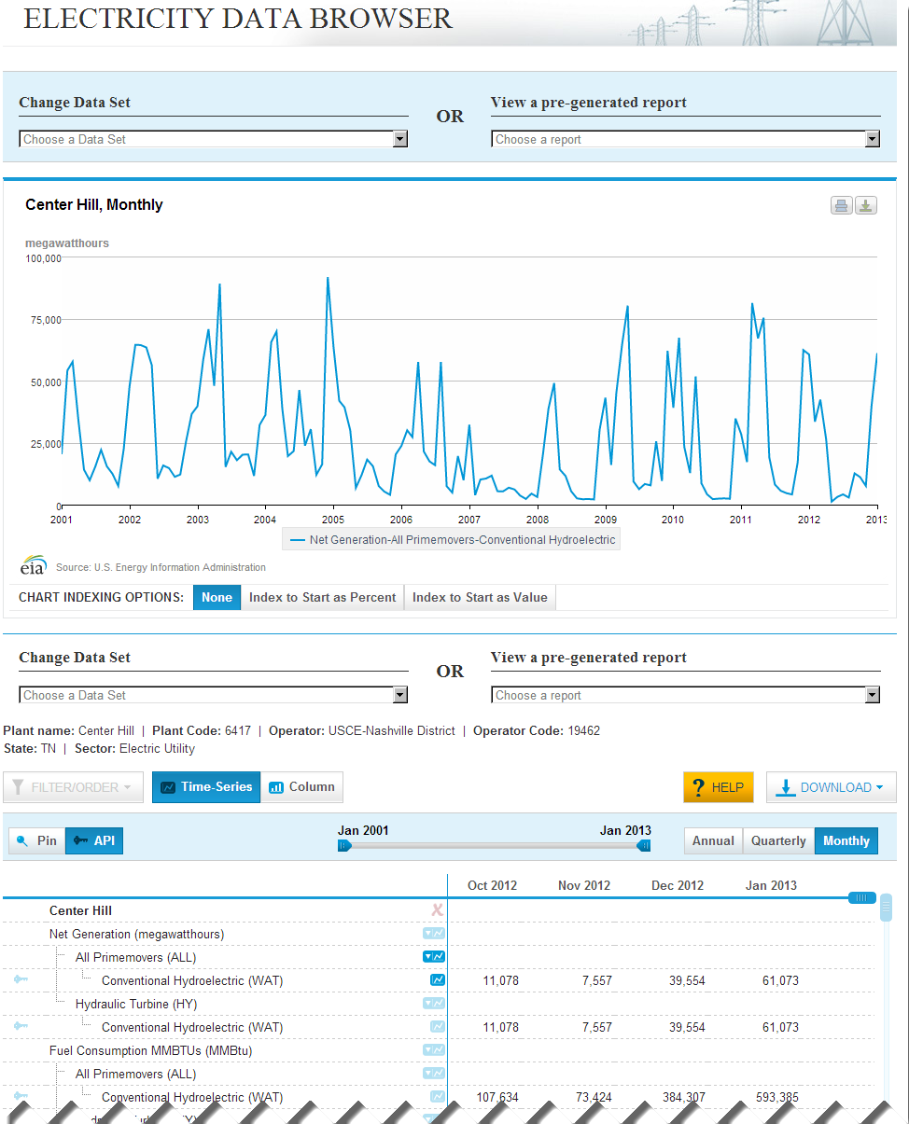
Data ecosystem
{"request":{"command":"series","series_id":"ELEC.PLANT.GEN.6417-WAT-ALL.A"},"series":[{"series_id":"ELEC.PLANT.GEN.6417-WAT-ALL.A","data":[["2012","244685"],["2011","390119"],["2010","251053"],["2009","377491"],["2008","181726"],["2007","102447"],["2006","292362"],["2005","263951"],["2004","471543"],["2003","444293"],["2002","422206"],["2001","285082"]],"name":"Net Generation : Center Hill : Conventional Hydroelectric : All Primemovers : Annual","units":"megawatthours","f":"A","unitsshort":"","description":"","copyright":"None","source":"EIA, U.S. Energy Information Administration","iso3166":"USA-TN","lat":"36.0972","lon":"-85.8274","start":"2001","end":"2012","updated":"22-MAR-13 03.12.35 PM"}]}

Slide 8
Demo: www.eia.gov
Notes:
Homepage > EDB: net gen (dataset + filter order + help) > map > Pennsylvania > filter on Three Mile island & view > US Energy Mapping system > wind farm > show api

Slide 9
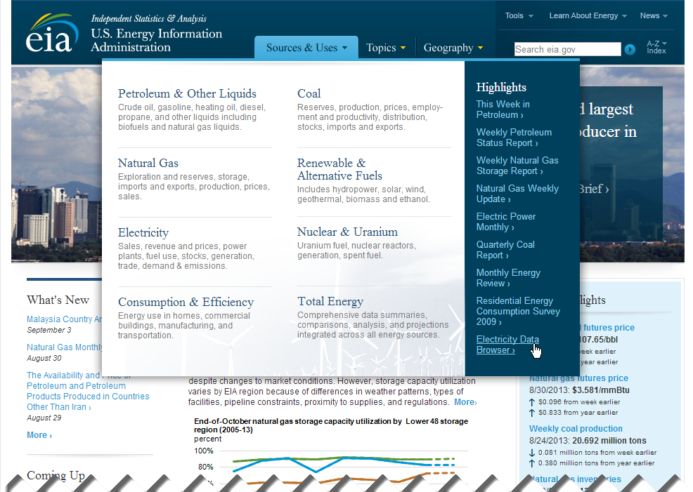

Slide 10
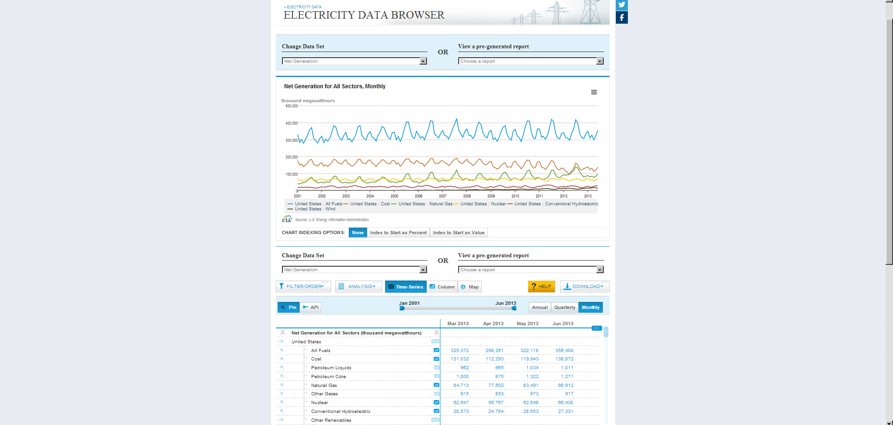
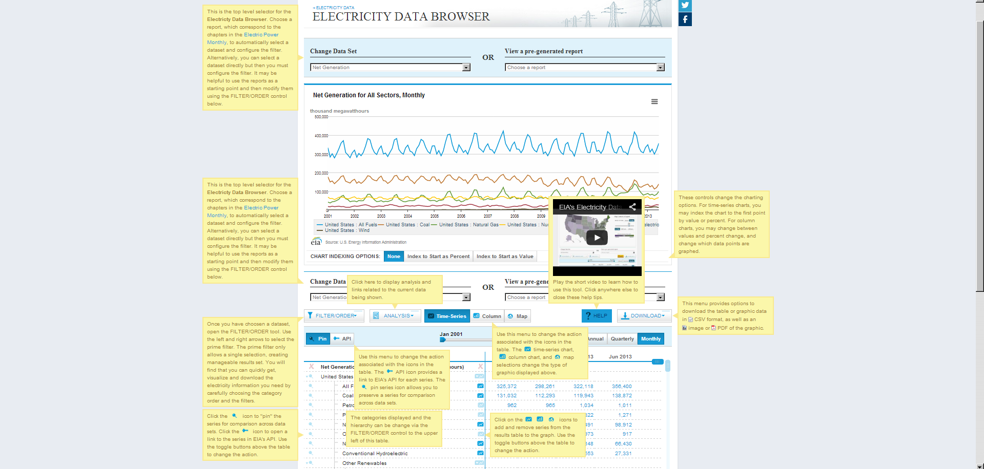

Slide 11
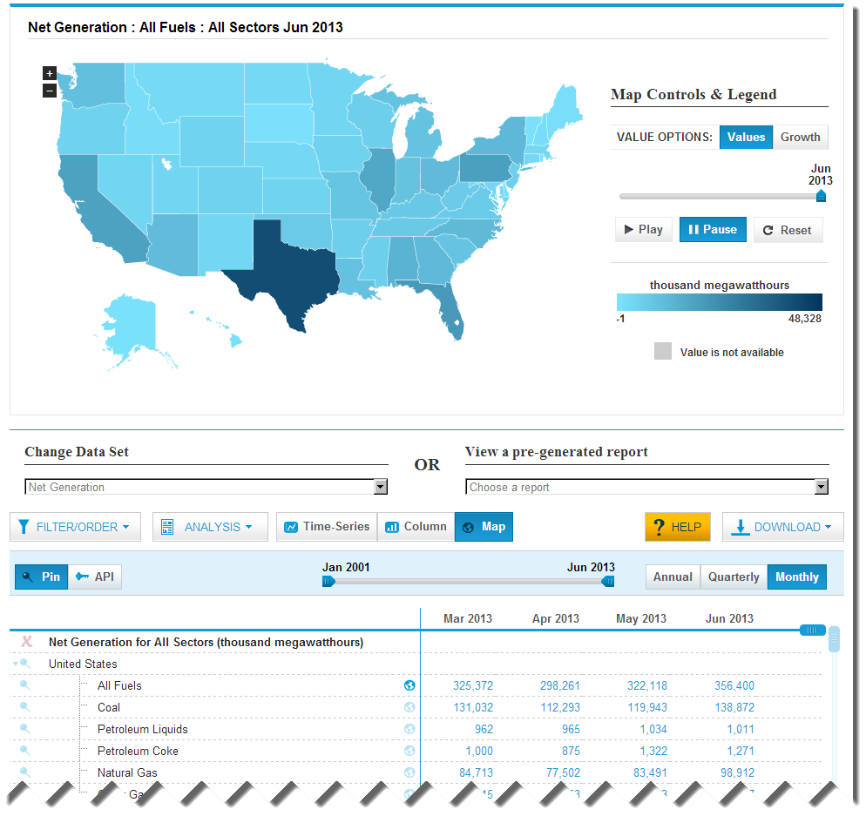

Slide 12
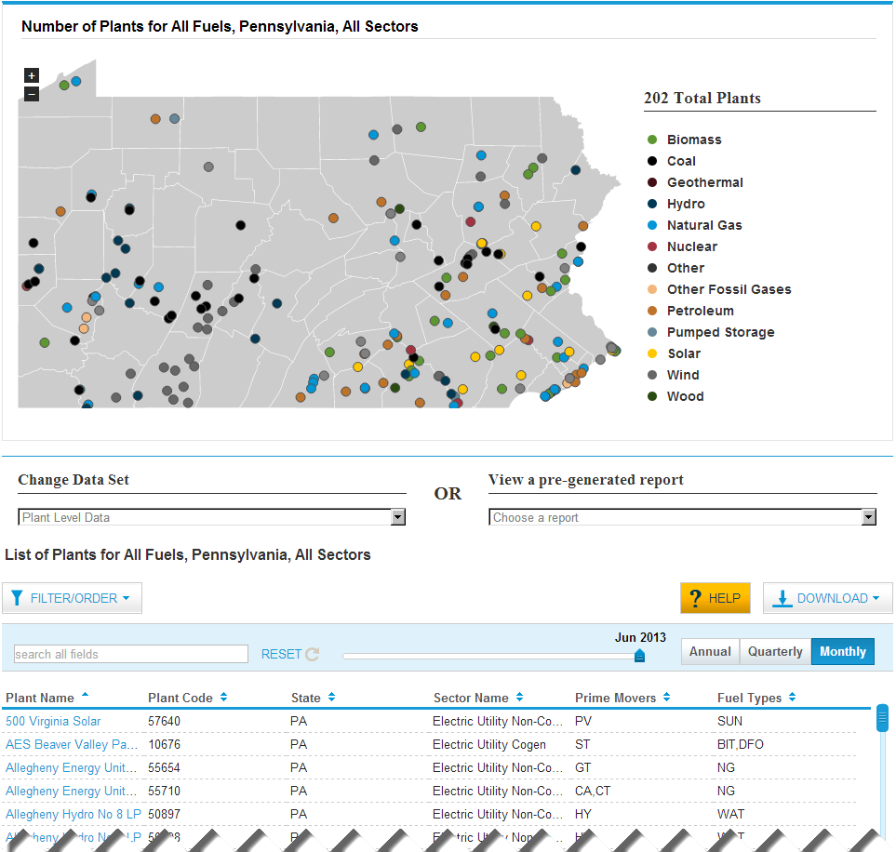
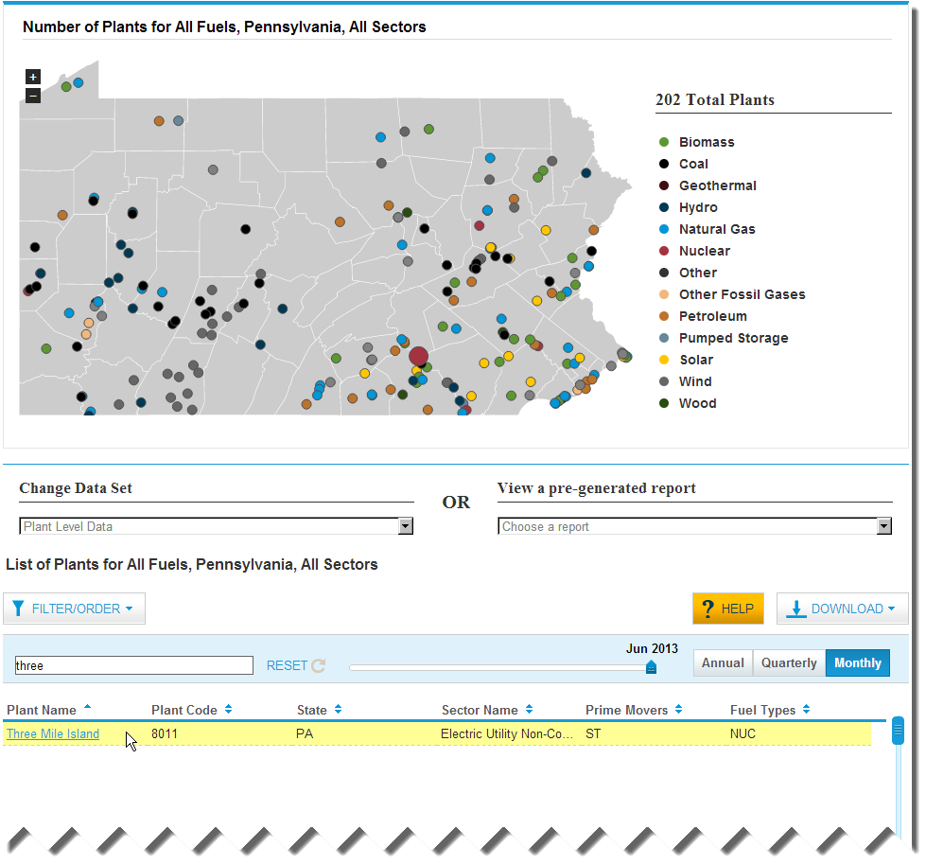

Slide 13
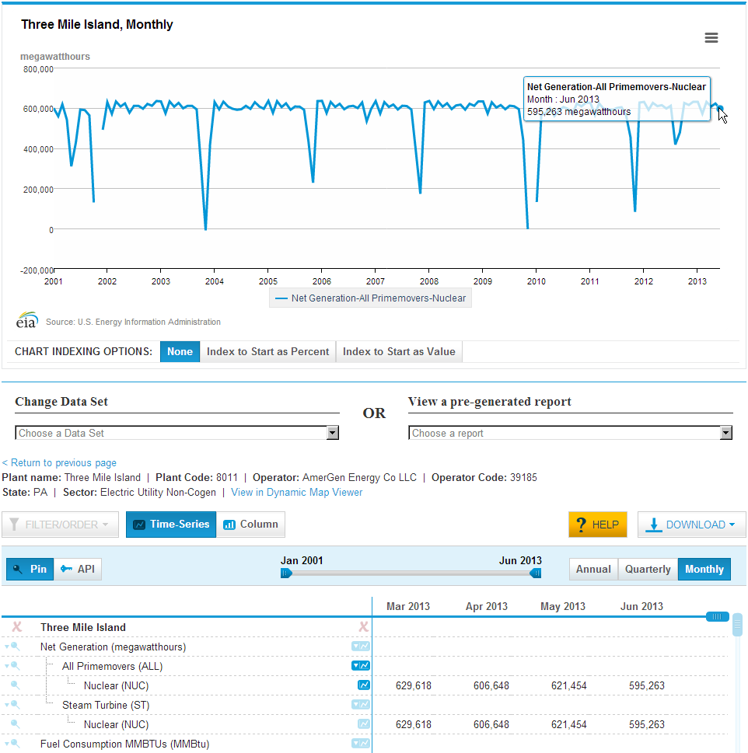
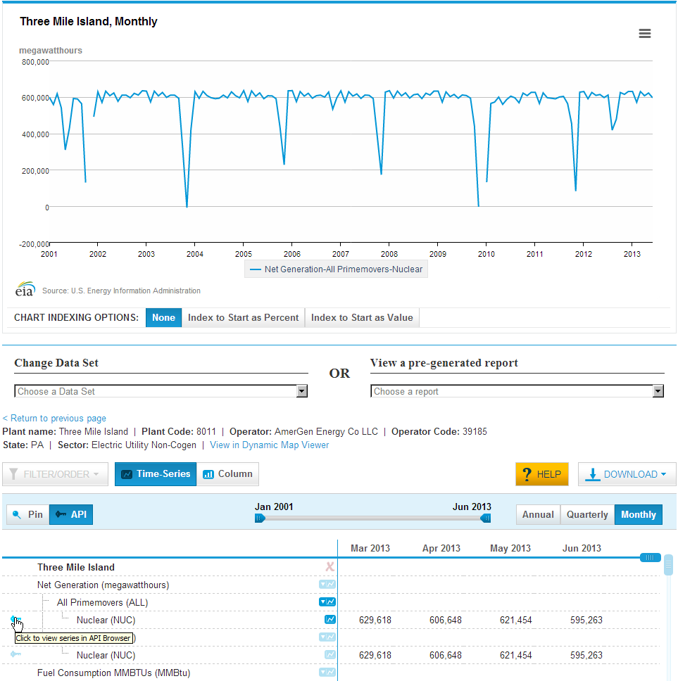
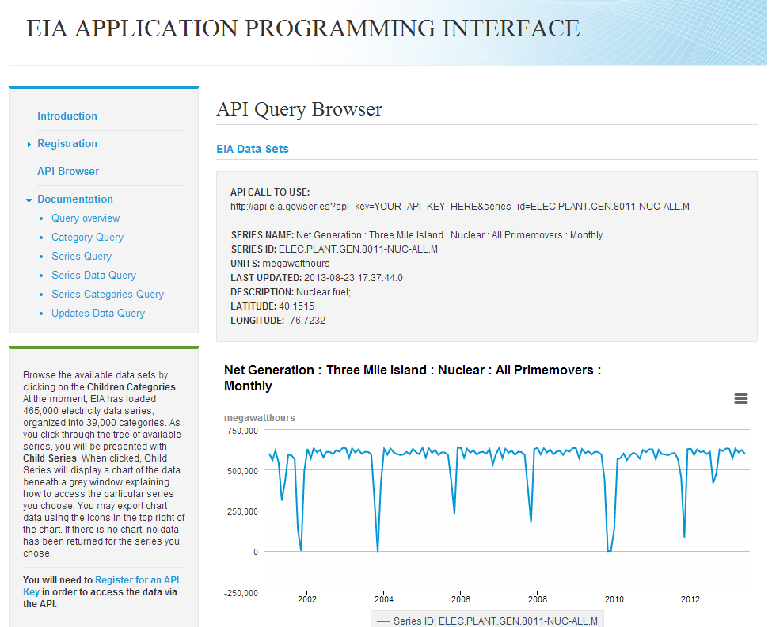

Slide 14
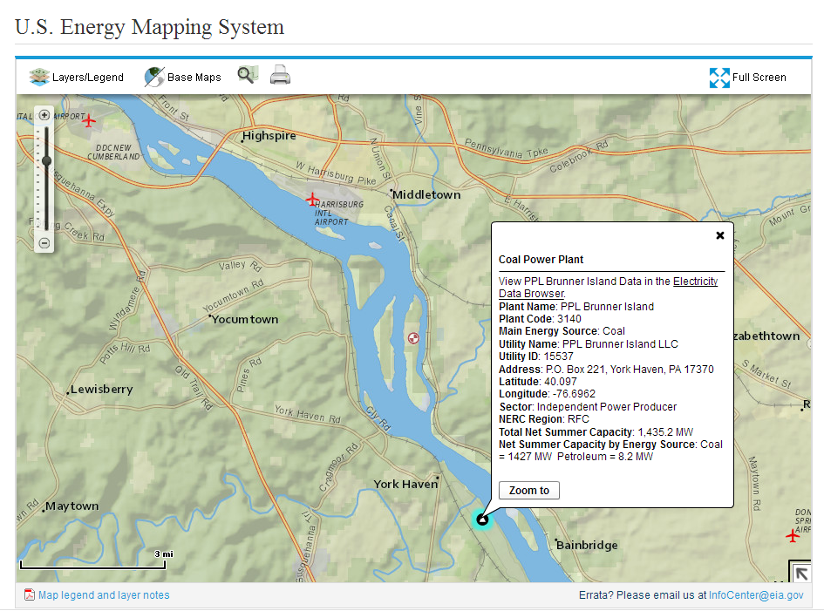

Slide 15
each data set is a complete n-Cube
Complete n-Cube
Ragged n-Cube
Notes:
Which is to say, the web db is a OLAP reporting database with all rollups are precalculated for speed and accuracy

Slide 16
Open Source libraries = 2/3 code
Name | Description | License | Version | Size | First published | Dependencies
jQuery | helper library; simplifies JavaScript coding | open-source | v1.7.1 | 92kB | Jan-06 | -
jQuery UI | user interface control | open-source | v1.8.7 | 202kB | Sep-07 | jQuery
Highstocks | charting library | commercial ($80) | v1.1.4 | 117kB | Oct-11 | jQuery
jVector Map | map infographics lib | open-source | v0.1 | 23kB | Feb-12 | jQuery
USA map definition | USA map definition | open-source | v0.1 | 47kB | Feb-12 | jVector Map, jQuery
SlickGrid | fast, scalable grid component | open-source | v2.0 | 12kB | Mar-09 | jQuery, jQuery.event. drag
JQuery Event Drag | extends jQuery; used by Slick | open-source | v2.0 | 5.1kB |  | jQuery
jQuery mousewheel | simplifies mousewheel programming | open-source | v3.0.6 | 3.5kB | Apr-07 | jQuery
Loadmask | creates wait screen effects | open-source | v0.4 | 4.1kB | Jun-09 | jQuery
qTips | help tips | open-source | v1.0 | 22kB | Apr-10 | jQuery
Curl | loads library as needed | open-source | v0.6.1 | 14.2kB | Jan-11 | -
Classy | objectoriented extension for JavaScript | open-source | v1.4 | 4.99kB | Apr-10 | jQuery
Crossroads | pattern matching framework | open-source | v0.7.1 | 5kB | Apr-11 | -
Hasher | url hash management | open-source | v1.1 | 2.8kB | Aug-11 | -
Mustache | logic-less template system | open-source | v0.5 | 14kB | Oct-09 | -
SimpleModal | creates modal panel (greys rest of screen) | open-source | v1.4.2 | 23kB | Oct-07 | jQuery
JSON2 | provides JSON support for obsolete browsers | open-source | v1.0 | 5kB | Nov-10 | -
PureMVC | model-view-controller framework | open-source | v1.1 | 7kB | Nov-10 | -
js-Signals | event framework | open-source | v0.7.4 | 3.1kB | Nov-10 | -
Kizzy | cross-browser localStorage API | open-source | v1.0 | 4.6kB | Feb-11 | -
Notes:
Three thing worth noting (1) number and variety. Many quite small, but they took problems off our plate so we could concentrate on business logic
(2) Note the dates.. Many are very recent… This project would not have been feasible 3 years ago. A new computing paradigm.
(3) Note the number of libraries which require jQuery. jQuery really has become the indispensible general helper library that makes complex web applications that will run on all browsers possible.

Slide 17
Questions?
Mark Elbert mark.elbert@eia.gov markelbert@gmail.com

