Slide 1
leveling the playing field for cancer genomics
Jack DiGiovanna, PhD
22 September 2016
Join the Conversation #WolframDataSummit

Slide 2
leveling the playing field for cancer genomics
Jack DiGiovanna, PhD
22 September 2016
@jack_digi
Join the Conversation #WolframDataSummit
Notes:
Connect the worlds biomedical information to improve research and health.
Don’t worry if you don’t know terms, I’m going to give you the cliff notes
No Precision Medicine here.
SEG: Team effort
Seven Bridges is a biomedical data analysis company accelerating breakthroughs in genomics research for cancer, drug development and precision medicine. The scalable, cloud-based Seven Bridges Platform empowers rapid, collaborative analysis of millions of genomes in concert with other forms of biomedical data.

Slide 3
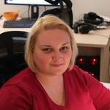
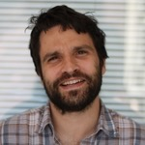
ACKNOWLEDGEMENTS
Brandi Davis-Dusenbery
Deniz Kural
Jelena Radenkovic
Vladimir Mladenovic
+ the Metadata Team
Dragan “Kodi” Bajcic
+ the Visualization Team
+ the excellent team powering the CGC
Notes:
SEG: title is cancer genomics, will frame in precision medicine

Slide 4
https://www.whitehouse.gov/precision-medicine
Notes:
Example of PM: Leukemia
SEG: Genetics in a slide

Slide 5
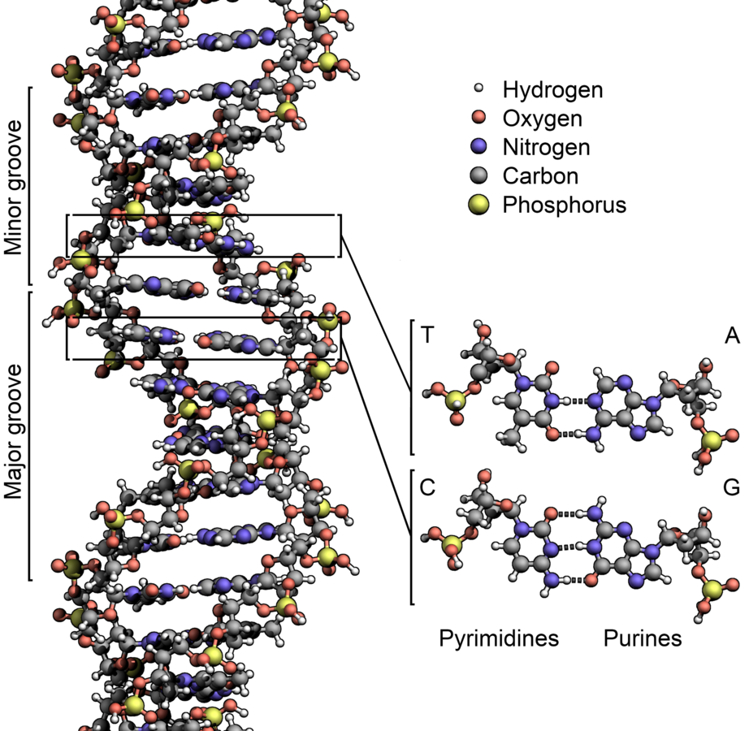
HOW DNA Works
(if you only have two slides)
DNA has four nucleotide bases: {A, T, C, G}
A human genome is a sequence of 3 billion bases
~99.5% of this is common between humans
Zephyris, CC BY-SA 3.0, https://commons.wikimedia.org/w/index.php?curid=15027555
Notes:
SEG: what does it do?

Slide 6
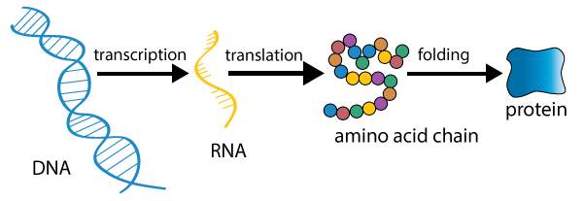
HOW DNA Works
(if you only have two slides)
DNA contains our genetic instructions, e.g. function, reproduction, growth
Differences account for who we are, e.g. green eyes, response to medications
Mutations may have no impact or may drive cancer or dysfunction
image: http://biosocialmethods.isr.umich.edu/epigenetics-tutorial/epigenetics-tutorial-gene-expression-from-dna-to-protein/
Notes:
About 1% is directly coding for proteins. Three-base codons make an amino acids
SEG: How can we investigate these differences?

Slide 7
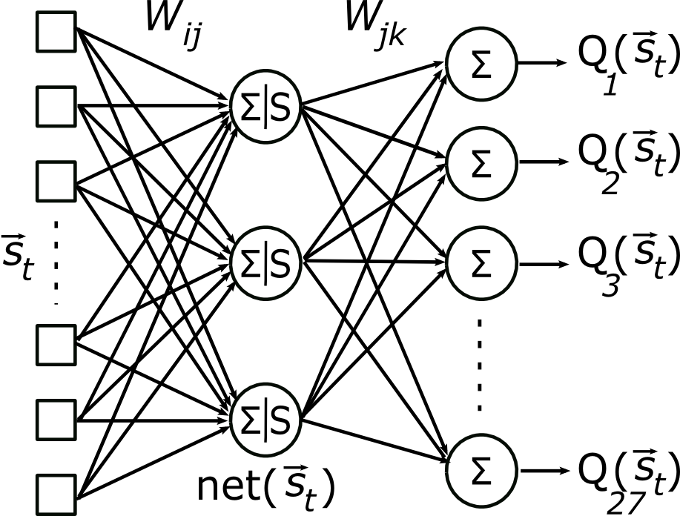
Machine Learning
Clustering to quantify patient similarity
Bayesian classification to stratify patients
Predictive modeling of disease and response
Sensitivity analysis of environmental, phenotype, and genotype factors
Choose your own adventure…
Notes:
my favorite tool, the multi-layer perceptron

Slide 8
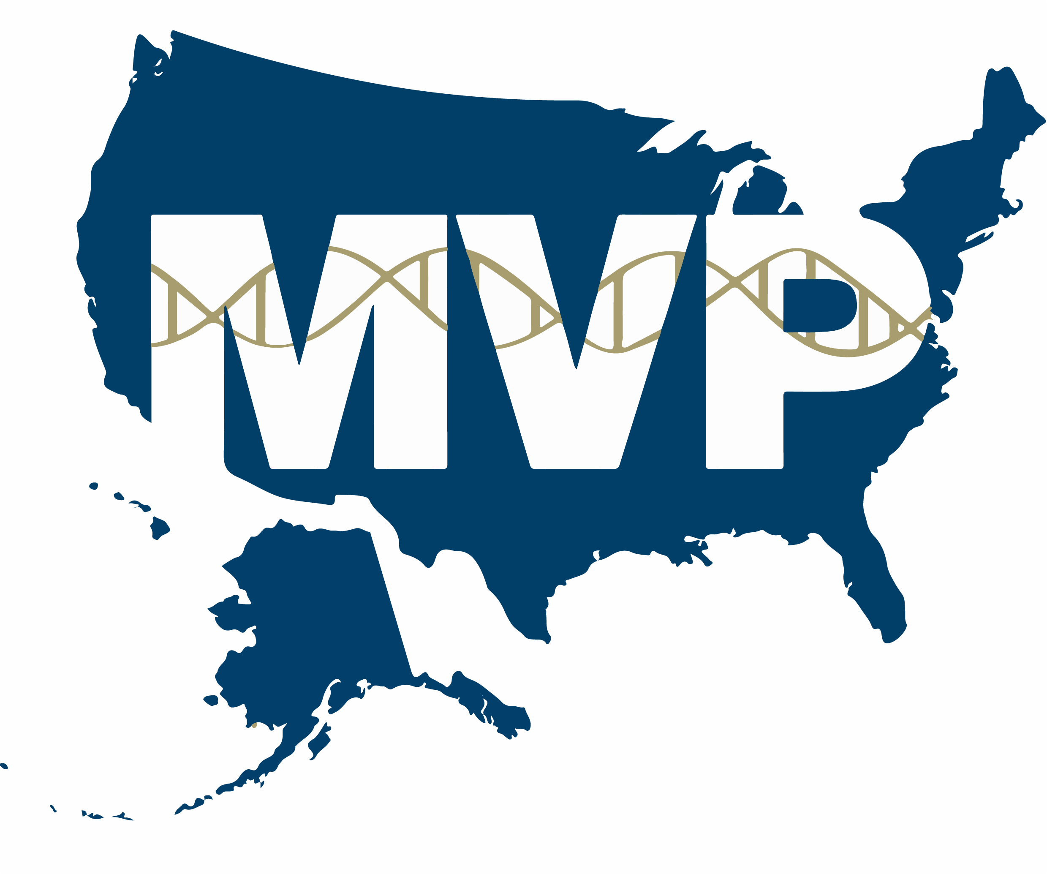
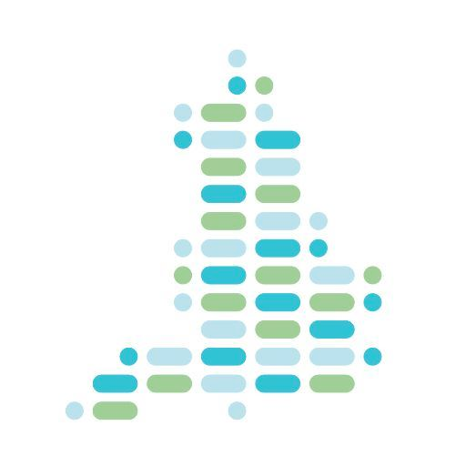
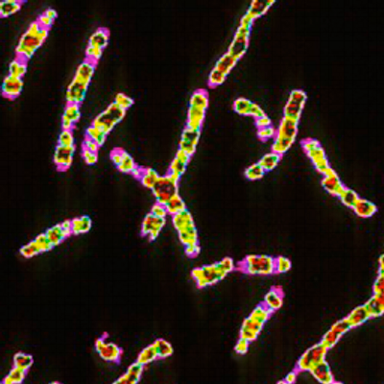
AstraZeneca
Million Veteran Program
Qatar Biobank
Genomics England; GenomeAsia 100k
TCGA
1000 Genomes
GTEx
Notes:
y-axis.
1000g was huge, now it’s expanded by orders of magnitude. We are involved also with CGC + Genomics England
SEG: Data is there. As a data scientist, we like ideas. But how is it possible? Going to the TCGA story

Slide 9
The tcGA research consortium

Slide 10
The cancer genome atlas (TCGA)
The mission was a “comprehensive and coordinated effort to accelerate the understanding of the molecular basis of cancer through the application of genome analysis technologies, including large-scale genome sequencing.”
Eventually >11,300 patients (cases) spanning 33 cancers were collected
Thousands of researchers collaborated to create a petabyte scale database
Notes:
Whole project cost more than $220 million.
SEG: when they did it

Slide 11
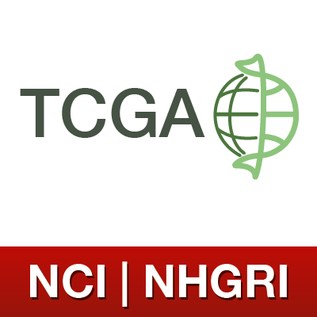
TCGA TIMELINE
Dec 2005: NIH launches effort
Nov 2006: NHGRI announces funding for sequencing centers
July 2007: TCGA awards funds; first data upload
April 2008: Revised consents
Sept 2009: NIH funds data analysis centers
April 2010: TCGA identifies novel subtypes of brain cancer
Sept 2010: Recovery Act expands TCGA
Jan 2012: CGHub created
Dec 2013: Sample collection stops ~20k biospecimens
Sept 2014: Seven Bridges awarded one of Cloud Pilots
June 2016: Genomic Data Commons opens
http://cancergenome.nih.gov/abouttcga/overview/history
Notes:
Used PCA to stratify novel subtypes of brain cancer, many other high impact publications since then
This is when Next Gen Sequencing appears - rather important.
SEG: The flow

Slide 12
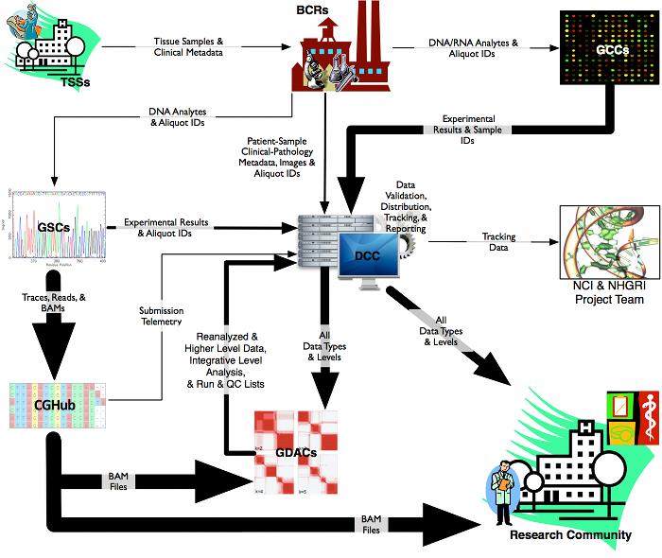
START
FINISH
https://wiki.nci.nih.gov/display/TCGA/Introduction+to+TCGA#IntroductiontoTCGA-TCGADataFlow
Notes:
Lot on this slide, walk through the path
SEG: Centers

Slide 13
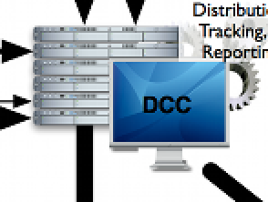
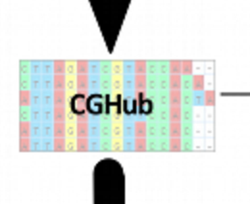
The data centers
Data Coordination Center (DCC) was the standard provider; it validated all submitted data and standardized formats
Called variants and genotyping data
Clinical and bio-specimen metadata
The Cancer Genomics Hub (CGHub) was the secure repository for hosting sequences and mutations from the TCGA project
Next Generation Sequencing (NGS) data was stored here
This was the “Big Data” that became available during the project
Notes:
SEG: organization

Slide 14
1.2 petabytes database with >500k files
Enormous effort to converge towards standardized formats
TCGA researchers collected >2000 clinical and bio-specimen metadata attributes
One of the best annotated datasets from a research perspective
https://www.etftrends.com/wp-content/uploads/2010/08/A-stack-of-files-001.jpg
Notes:
SEG: dig into this metadata

Slide 15
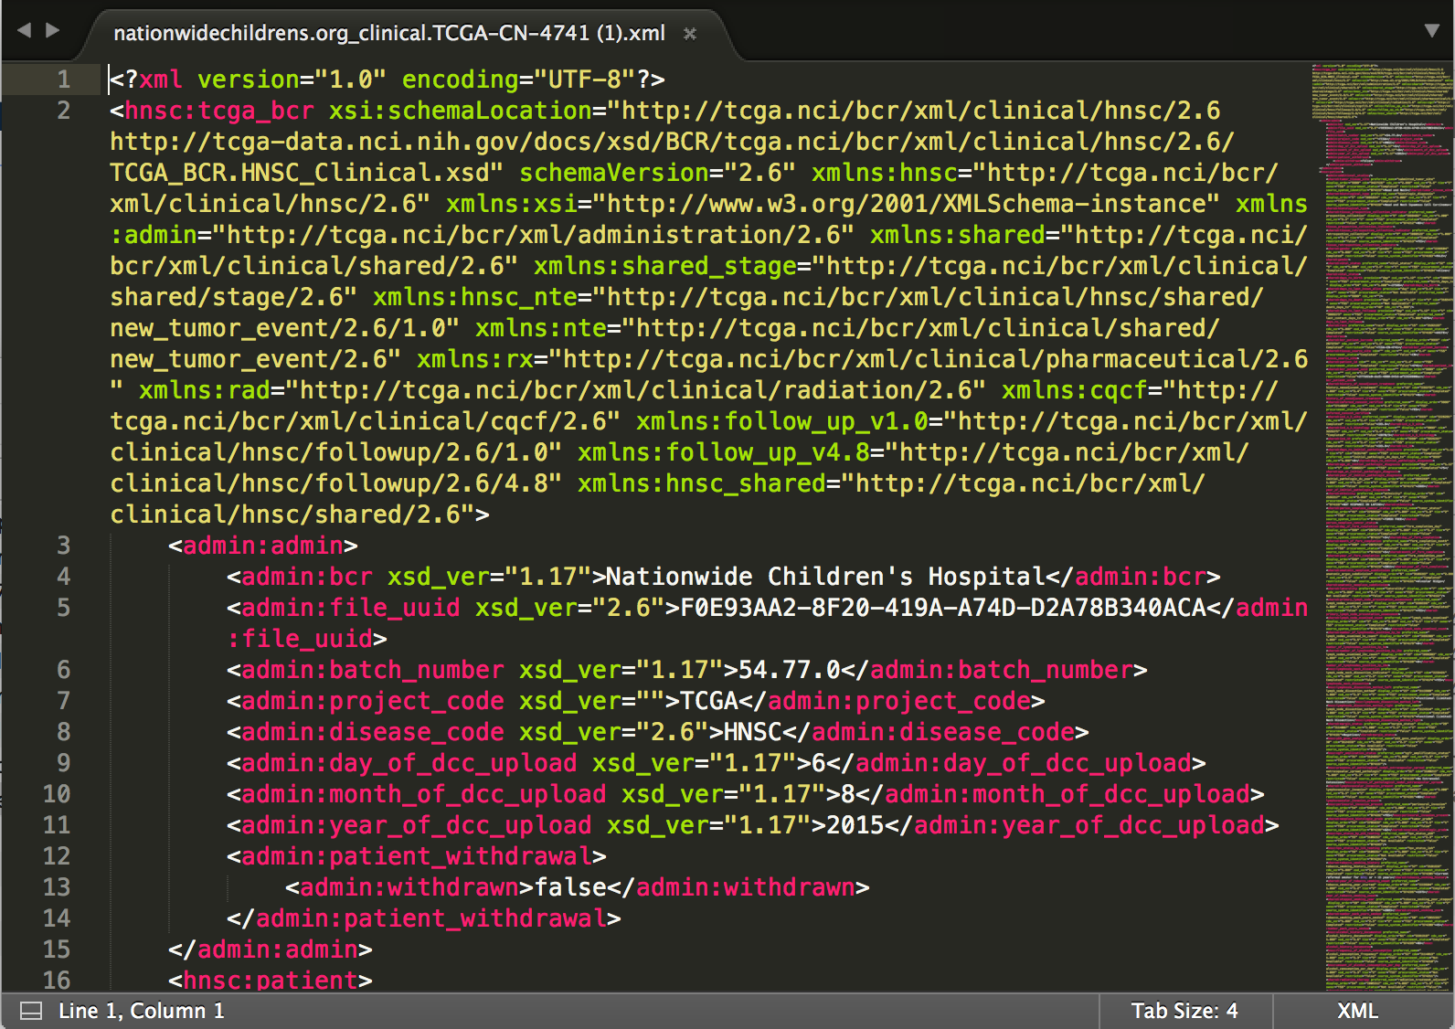
Data Coordination Center (DCC) metadata
Table of ~10 metadata properties
Not connected to CGHub
Semi-structured xml files with additional information
Different formatting based on research center
Patient identifier was a barcode
Barcode largely formed by metadata
Notes:
SEG: CGHub

Slide 16
Cancer Genomics Hub (CGHub) metadata
CGHub introduced new identifiers to cope with file logistics issues that were arising
These identifiers needed to be mapped back to DCC barcodes
Table of ~20 metadata properties listed, not connected to DCC

Slide 17
“study drug-stage interaction in Prostate Cancer”
Go to DCC, download all prostate cancer files
Parse all XML files for drug and stage
Form cohort of Cases
Map this cohort to their CGHub identifiers
Pull all data matching those Cases from CGHub
Find out I only have N samples of that type
Previously very difficult query: “all matched tumor-normal samples”
Notes:
matched tumor-normal sample pairs : Required the flow above 2x then a matching.
SEG: Big labs were slightly better at this - they had built up systems to manage. However, no path to the public.

Slide 18
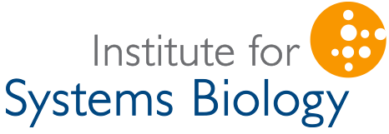
Enter the “Cloud Pilots”
Democratize the TCGA data by sharing it & making it usable.

Slide 19
Cleaning & harmonizing metadata

Slide 20
Many fields to “represent a clinical picture”
It took a long time to understand the 2,000 metadata properties
Extracted all properties to find the distributions for each
Interviewed researchers and gathered community feedback
Some metrics were (mostly) unique to particular cancers
Prostate Specific Antigen (PSA) levels in prostate cancer
Smoking history and lung cancer
Notes:
Getting community feedback

Slide 21
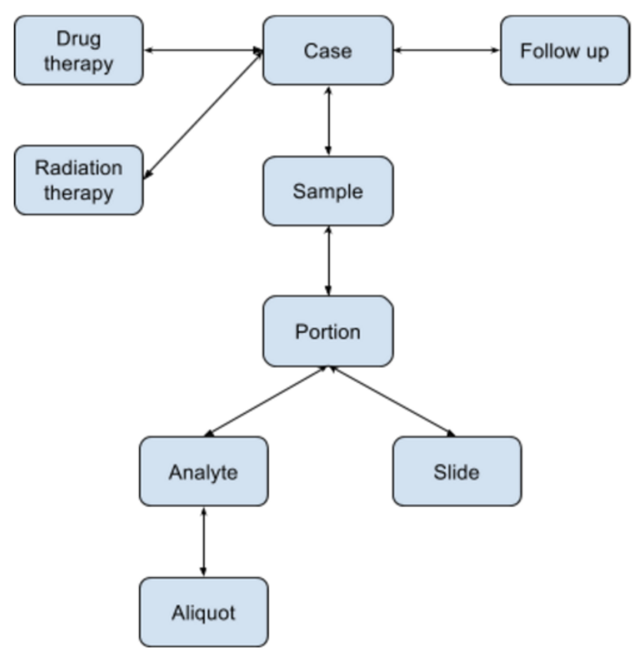
Pseudo-code
Select (heuristically) parameters by:
Minimize sparsity
Maximize usability
Eventually decided on 106 parameters organized into 10 entities
Additional design considerations:
Users previously had tabular data
Structure similar to user expectations
Huge drop-down list not great
Notes:
Choosing the optimal set.
SEG: Heuristics allows a start but we are not sure if it will generalize, so RDF

Slide 22
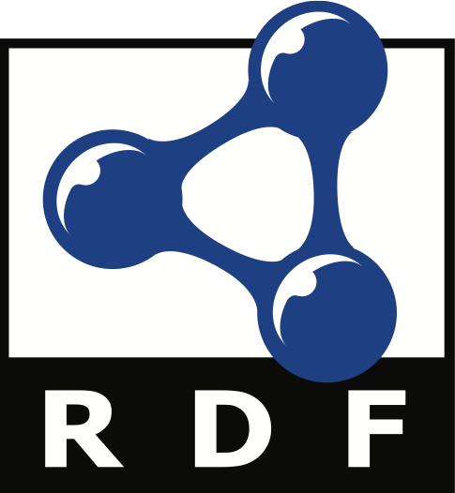
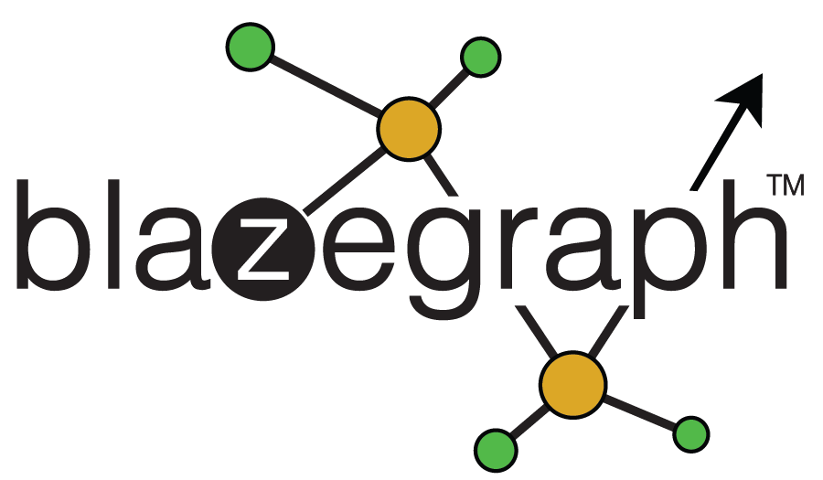
Building the data model
Resource Description Framework (RDF) was well suited to this task
Allows building on the fly as we were unaware of complete data model
Allows easily adding new files as the dataset grows
Fit our vision of a graph-based search
http://www.w3.org/RDF/icons
Can incorporate synonyms (HR, BPM, heart rate)
Challenging problem in TCGA, critical capability for future expansion
Built upon Blazegraph
Open-source, GDL tool
http://www.aveyacreative.com/folio/
Notes:
Again RDF good because allows synonyms
SEG: Summarizing the data model

Slide 23
metadata properties

Slide 24
ENABLING PRECISION MEDICINE
Notes:
SEG: Data model and precision Med

Slide 25
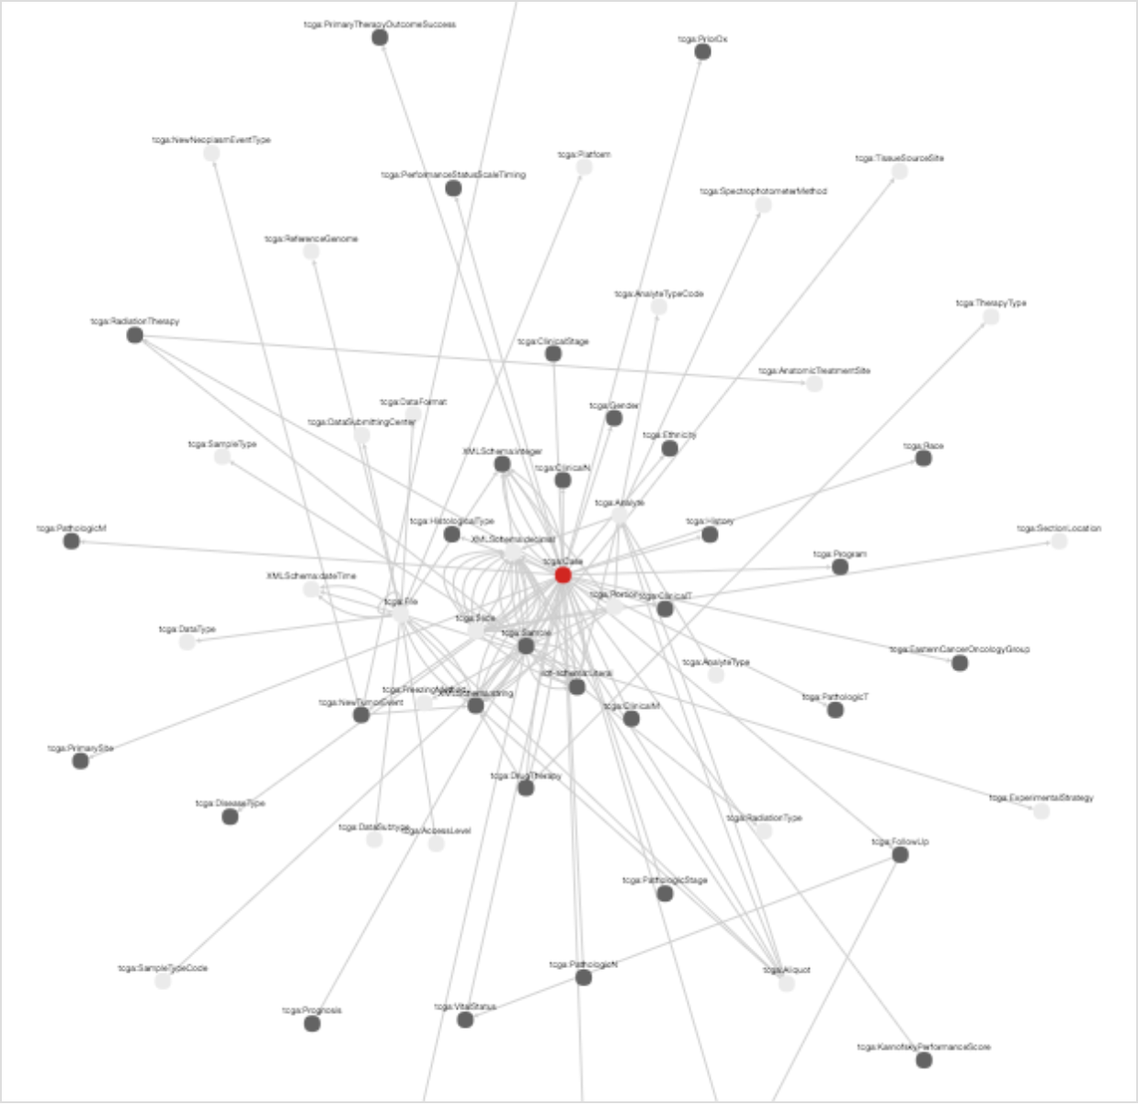
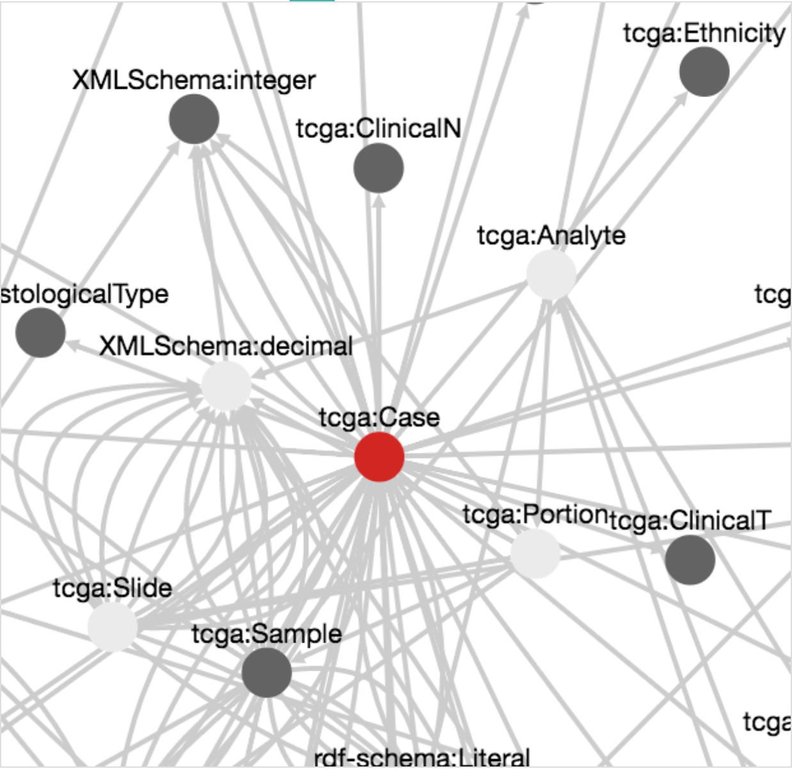
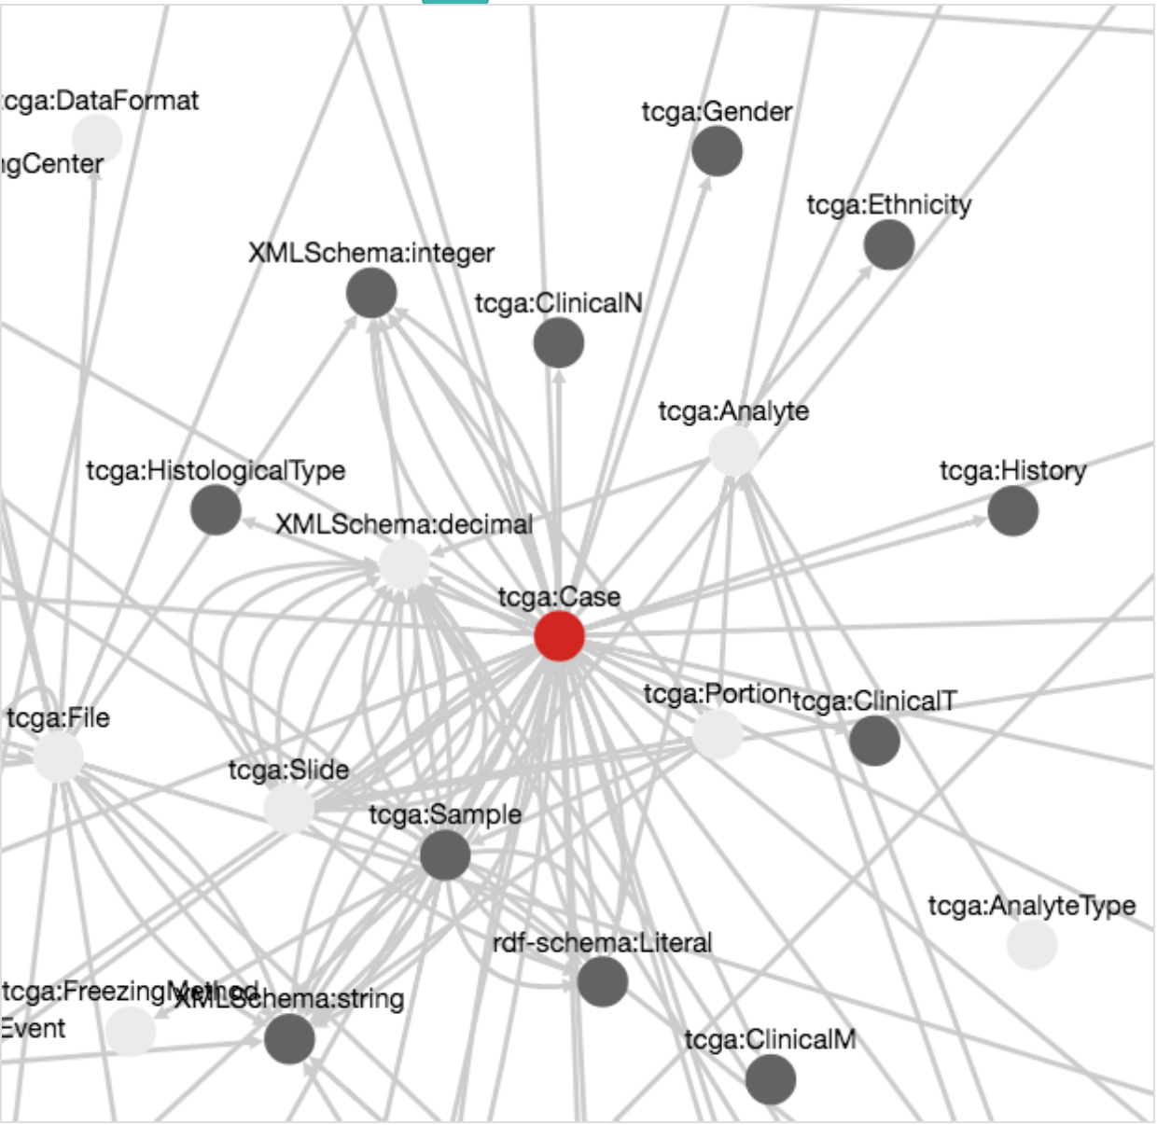
Notes:
two clicks
SEG: What does this enable for the users

Slide 26
Rapid OVERVIEW
Notes:
Are there enough samples?
SEG: specific queries

Slide 27
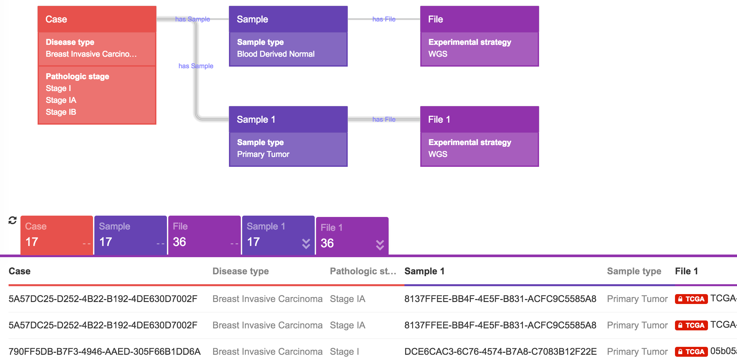
Tumor-normal pairs
Sample and Phenotype
Notes:
SEG: Dealing with hundreds of Gb files and compute non-trivial

Slide 28
Empowering Analysis
Data can be immediately copied into a project and shared with collaborators
Scalable compute instances for additional processing
More than 200 bioinformatics tools are publicly available.
Researchers can also create their own tools
http://www.cancergenomicscloud.org/
Notes:
Can analyze this directly on bare AWS
Collaborators with appropriate permission

Slide 29
researchers on the cancer genomics cloud…
Identifying novel epitopes across cancer samples
Predicting survival from tumor heterogeneity and whether this is dependent on cancer type or variant caller used
Detecting novel gene fusions from RNA sequencing with near-zero false positive rate
Comparing viral infection patterns across cancer types and their relationship to patient outcome
Notes:
epi-e-topes
SEG: how does this scale?

Slide 30
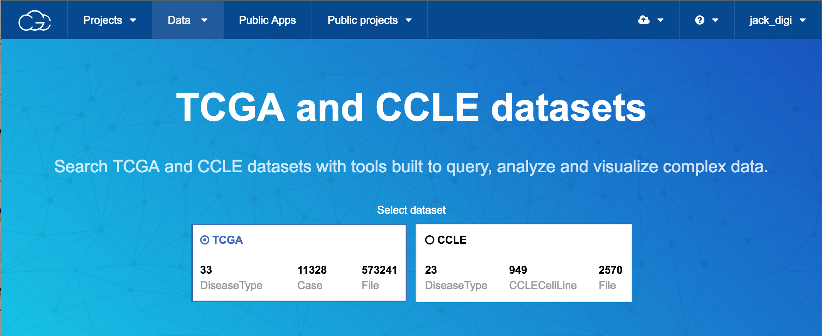
scaling and future directions
Federated queries can further enhance power by joining to other databases
TCGA data was designed for research, how can we match it with other national projects using less-precise EMR?
Notes:
Future work
SEG: summing up

Slide 31
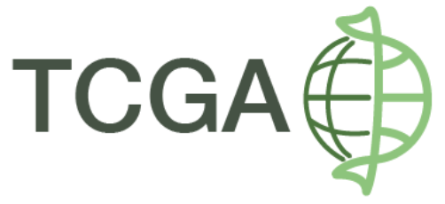
summary
We created a model for TCGA data by unifying collected metadata fields. The semantic triple store facilitates rapid queries to create user-defined cohorts
The model will be expanded to incorporate cancer-specific properties
Providing this access to TCGA data allows users to bypass data-cleaning and instead focus their energy on secondary analysis and data science
Cancer researchers are already finding novel results; we encourage data scientists to also join the fight
@genomicscloud
This project has been funded in whole or in part with Federal funds from the National Cancer Institute, National Institutes of Health, Department of Health and Human Services, under Contract No. HHSN261201400008C.
Notes:
Patients

Slide 32
Extra Slides

Slide 33
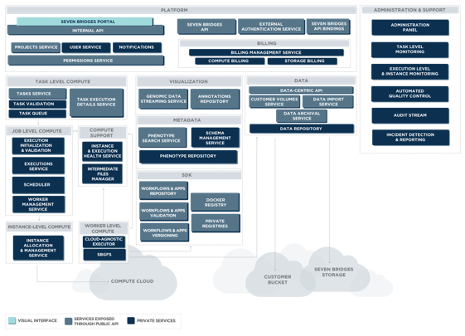

Slide 35
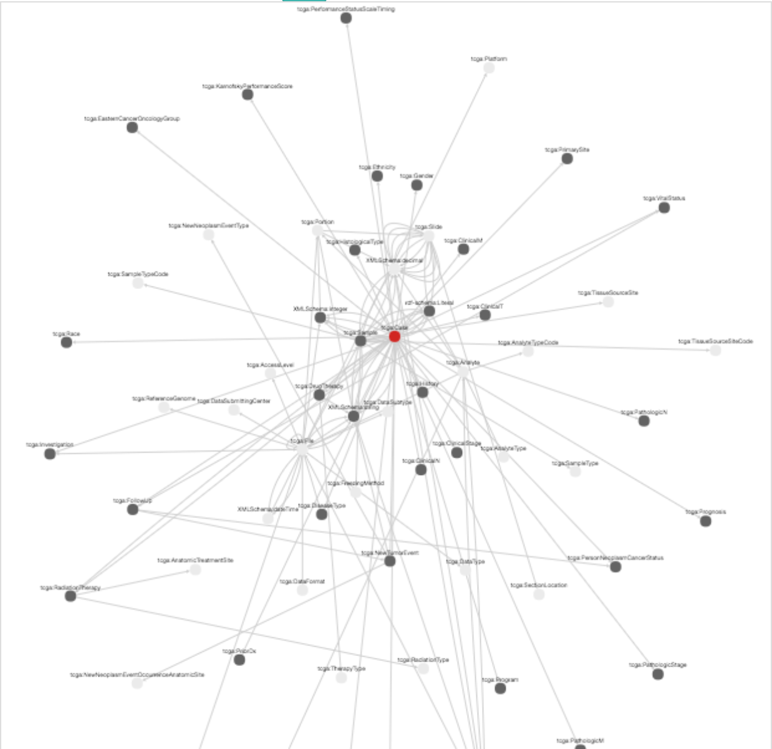
leveling the playing field for cancer genomics
Jack DiGiovanna, PhD
22 September 2016
@jack_digi
Join the Conversation #WolframDataSummit
Notes:
Connect the worlds biomedical information to improve research and health.
Seven Bridges is a biomedical data analysis company accelerating breakthroughs in genomics research for cancer, drug development and precision medicine. The scalable, cloud-based Seven Bridges Platform empowers rapid, collaborative analysis of millions of genomes in concert with other forms of biomedical data.
Don’t worry if you don’t know terms, I’m going to give you the cliff notes
No Precision Medicine here.
SEG: Team effort

Slide 36
Precision Medicine capabilities
Can rapidly stratify and assess tumor-normal pairs, this is critical
for understanding patient-specific differential expression of genes
or presence of variants
Pan-Cancer Analysis allows searching across cancers to find commonalities
in genetic variants, environmental factors, or treatment response. Generates novel and potentially actionable therapeutic targets
Straightforward to organize and analyze longitudinal samples over the course of a patient’s life - from pre-natal testing to to diagnosis to treatment to remission
Notes:
SEG: how does this scale?

